Slide 1
Introduction to Classes, Objects, Methods and strings
Chapter 4 of Visual C# How to Program, 6/e

Slide 2
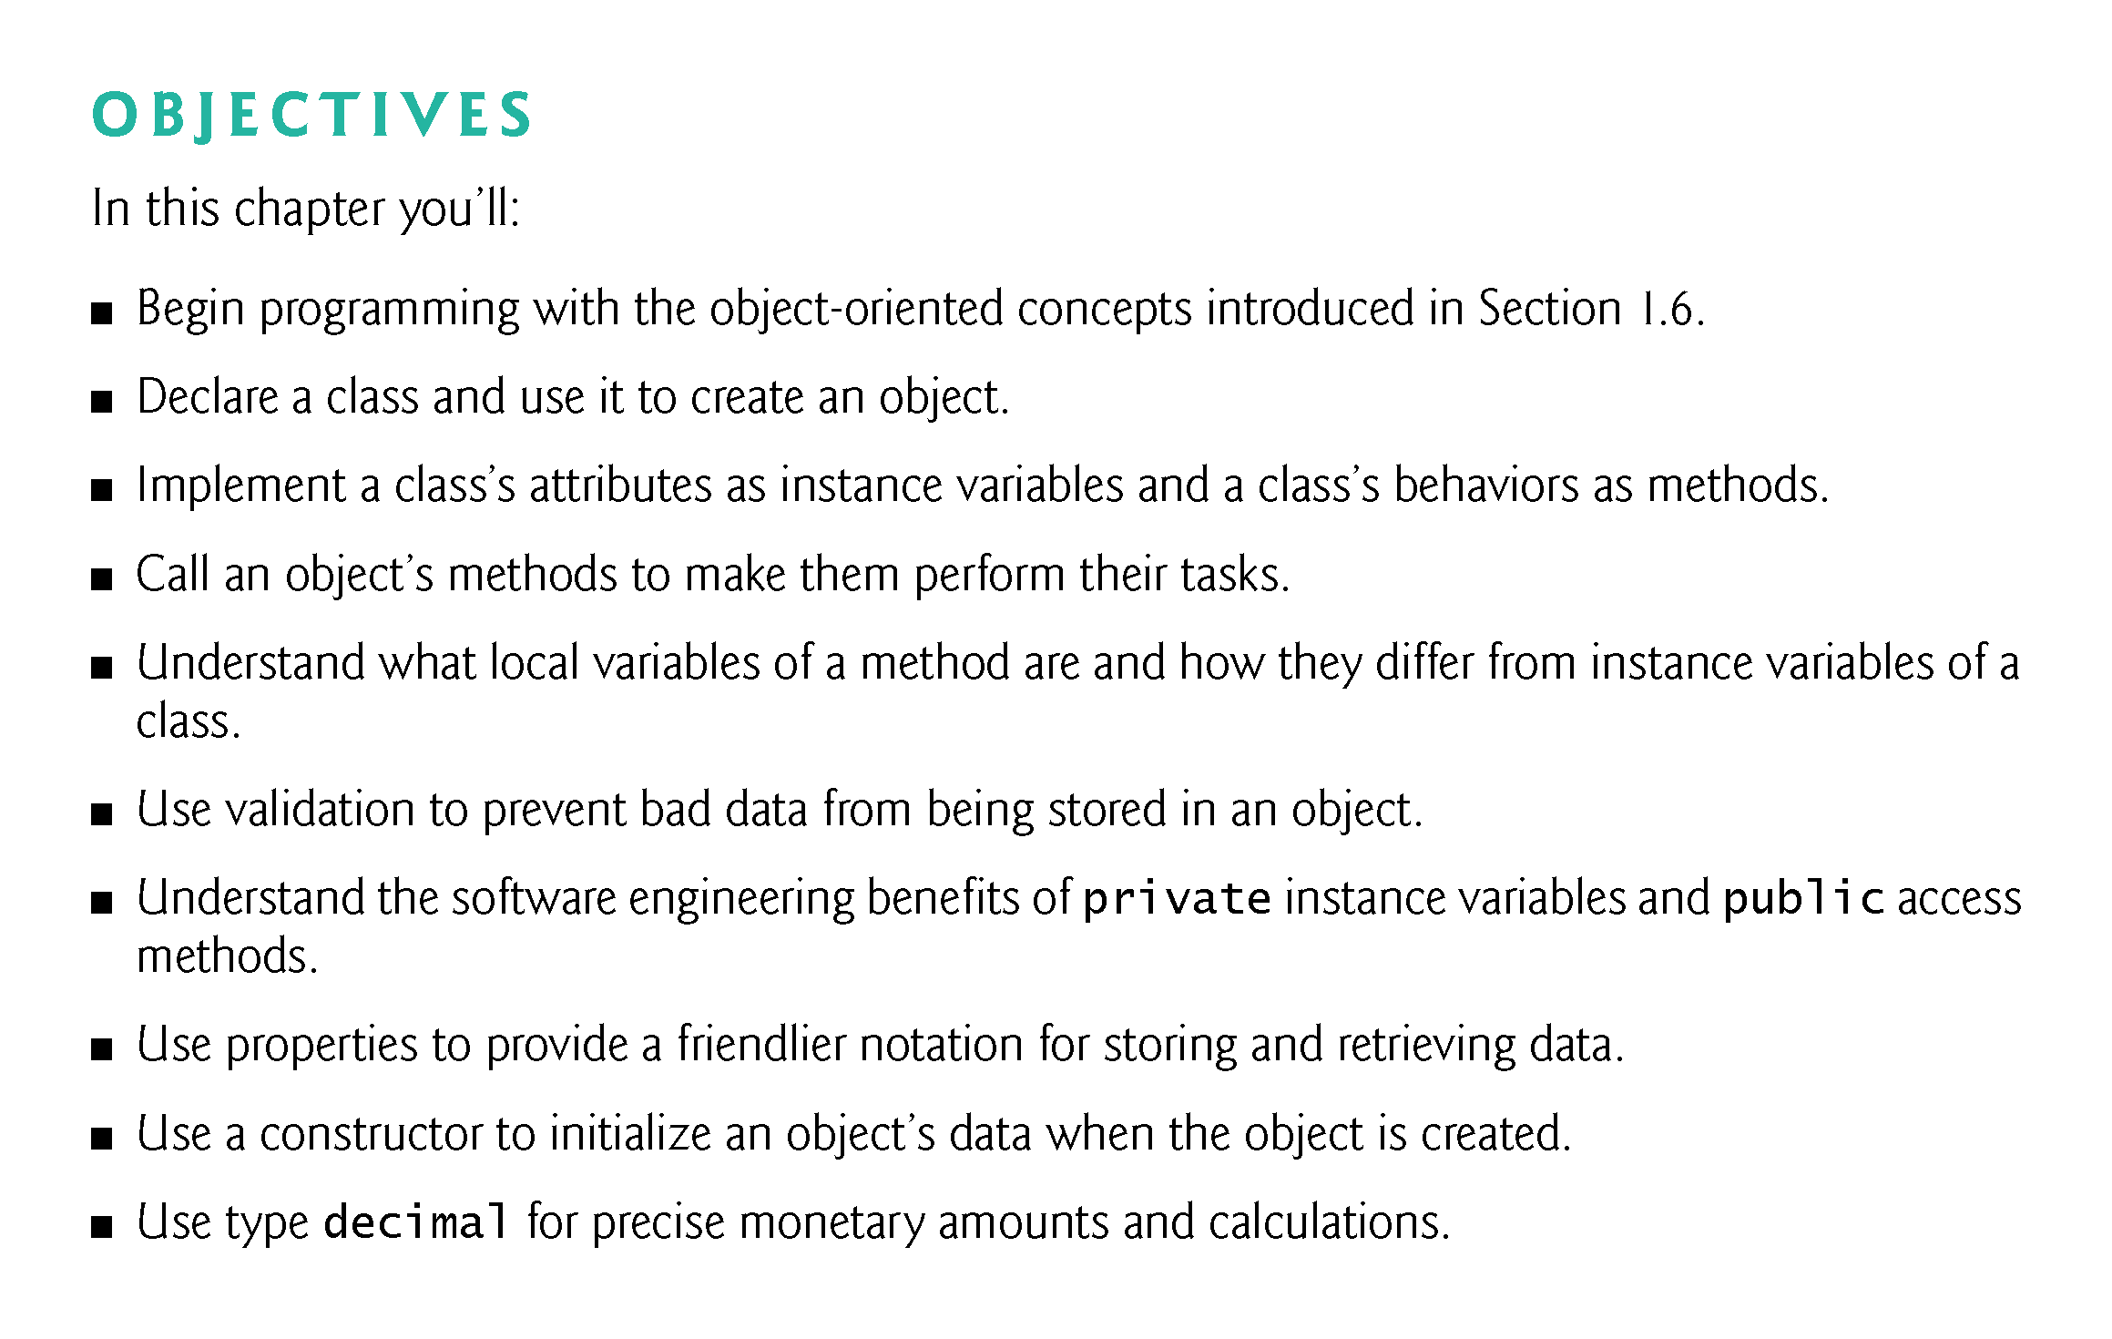

Slide 3
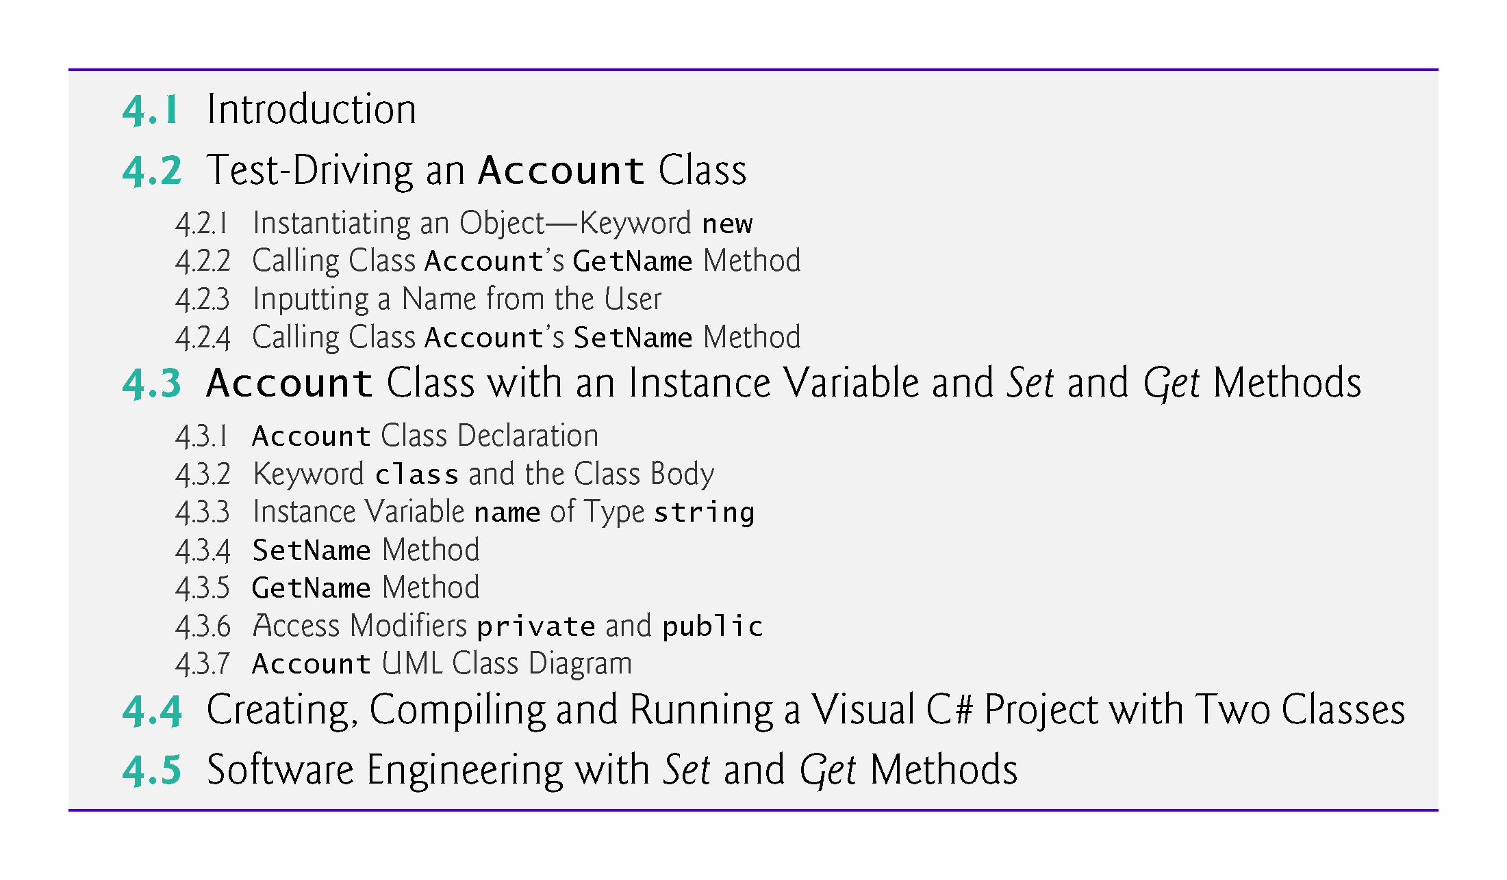

Slide 4
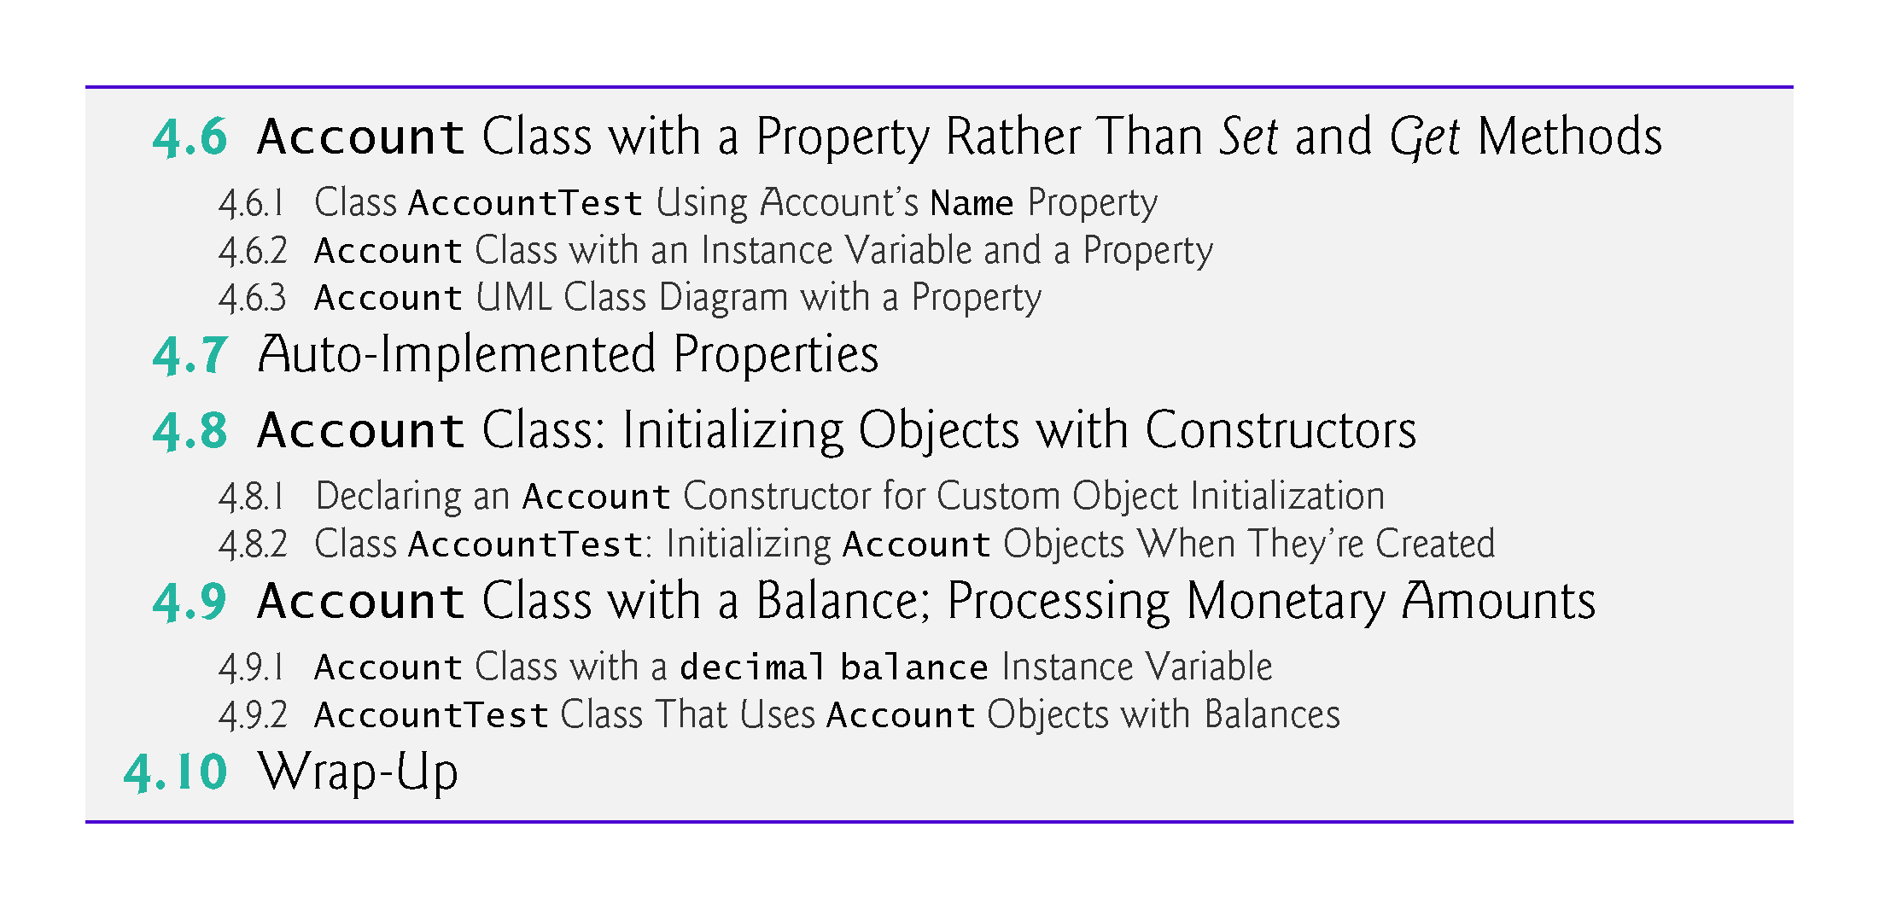

Slide 5
4.1 Introduction
Each class you create becomes a new type you can use to create objects, so C# is an extensible programming language.
Major development teams in industry work on applications that contain hundreds, or even thousands, of classes.

Slide 6
4.2 Test-Driving an Account Class
A person drives a car by telling it what to do (go faster, go slower, turn left, turn right, etc.)—without having to know how the car’s internal mechanisms work.
Similarly, a method (such as Main) “drives” an Account object by calling its methods—without having to know how the class’s internal mechanisms work.
In this sense, the class containing method Main is referred to as a driver class.

Slide 7
4.2 Test-Driving an Account Class
To help you prepare for the larger programs you’ll encounter later in this book and in industry, we define class AccountTest and its Main method in the file AccountTest.cs (Fig. 4.1).
We define the Account class in its own file as well (file Account.cs, Fig. 4.2).

Slide 8
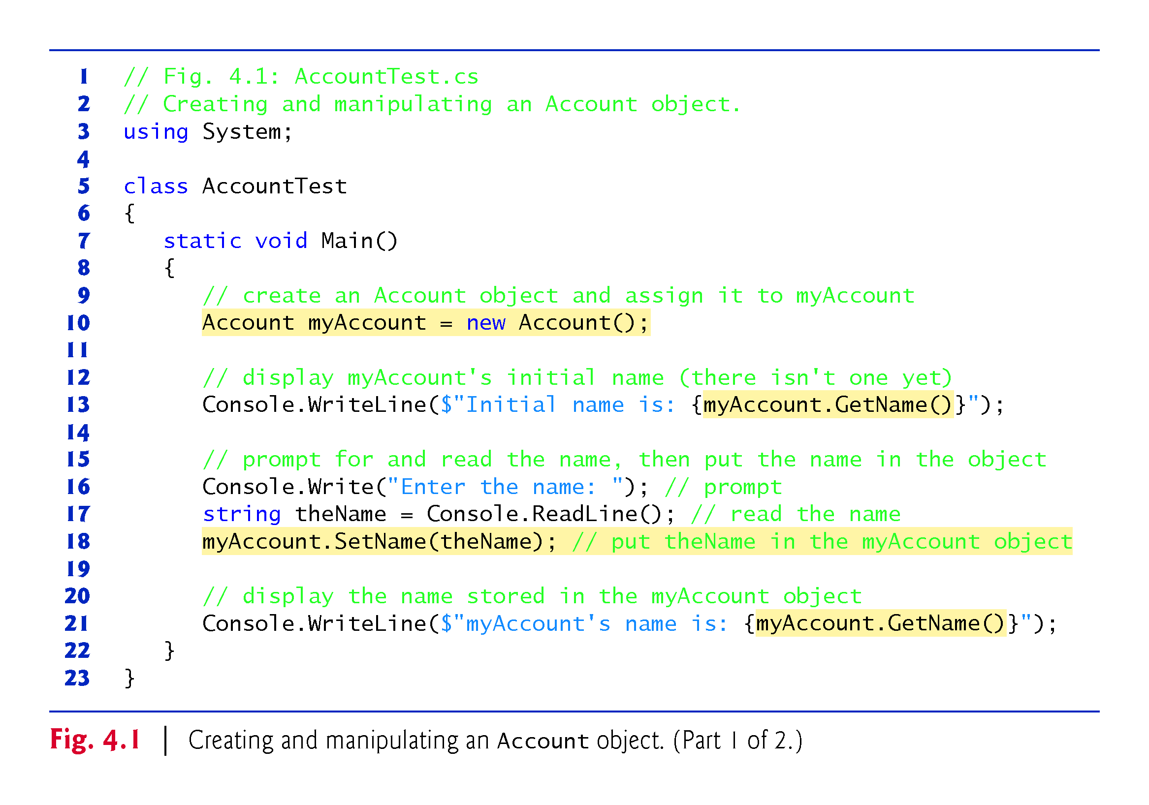

Slide 9
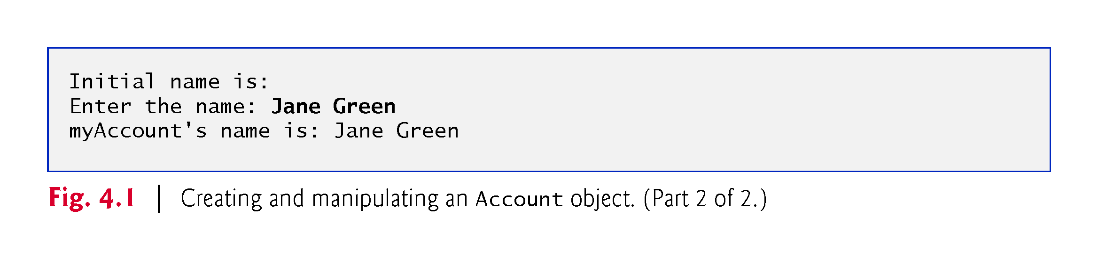

Slide 10
4.2.1 Instantiating an Object—Keyword new
Typically, you cannot call a method of a class until you create an object of that class.
You’ll see in Section 10.9 that static methods (and other static class members) are an exception.
Account myAccount = new Account();
Uses an object-creation expression to create an Account object, then assigns it to the variable myAccount. The variable’s type is Account.
Keyword new creates a new object of the specified class.

Slide 11
4.2.2 Calling Class Account’s GetName Method
The Account class’s GetName method returns the account name stored in a particular Account object.
To call this method for a specific object, you specify
the object’s name (myAccount) followed by
the member access operator (.),
the method name (GetName) and
a set of parentheses.
The empty parentheses indicate that GetName does not require any additional information to perform its task.

Slide 12
4.2.2 Calling Class Account’s GetName Method
When Main calls the GetName method:
The app transfers execution from the expression myAccount.GetName() (line 13 in Main) to method GetName’s declaration (Fig. 4.2).
Because GetName was accessed via the object myAccount, GetName knows which object’s data to manipulate.
Next, method GetName performs its task—that is, it returns the myAccount object’s name to line 13 where the method was called.
Console.WriteLine displays the string returned by GetName—the name is inserted into the interpolated string in place of the call to GetName—then the program continues executing at line 16 in Main.
Because we have not yet stored a name in the myAccount object, line 13 does not display a name.

Slide 13
4.2.3 Inputting a Name from the User
Lines 16–17 prompt for and input a name.
Line 17 uses Console method ReadLine to read the name from the user and assign it to the string variable theName.
Method ReadLine reads a whole line, including all the characters the user types until the newline that the user typed by pressing Enter—the newline is discarded.
Pressing Enter also positions the output cursor to the beginning of the next line in the console window, so the program’s next output begins on the line below the user’s input.

Slide 14
4.2.4 Calling Class Account’s SetName Method
Account’s SetName method stores (sets) an account name in a particular Account object.
Line 18 calls myAccount’s SetName method, passing theName’s value as SetName’s argument.
myAccount.SetName(theName); // put theName in the myAccount object
The method stores this value in the object myAccount.

Slide 15
4.2.4 Calling Class Account’s SetName Method
When Main calls the SetName method:
The app transfers program execution from line 18 in Main to method SetName’s declaration.
Because method SetName was accessed via the myAccount object, SetName “knows” which object to manipulate.
Next, method SetName stores the argument’s value in the myAccount object .
When SetName completes execution, program control returns to where method SetName was called (line 18 in Main), then execution continues at line 21.

Slide 16
4.3 Account Class with an Instance Variable and Set and Get Methods
The fact that in we could create and manipulate an Account object without knowing its implementation details is called abstraction.
This is one of the most powerful software-engineering benefits of object-oriented programming.

Slide 17
4.3.1 Account Class Declaration
Class Account (Fig. 4.2) contains a name instance variable (line 7) that stores the account holder’s name
each Account object has its own copy of the name instance variable.
Class Account also contains method SetName that a program can call to store a name in an Account object, and method GetName that a program can call to obtain the name from an Account object.

Slide 18
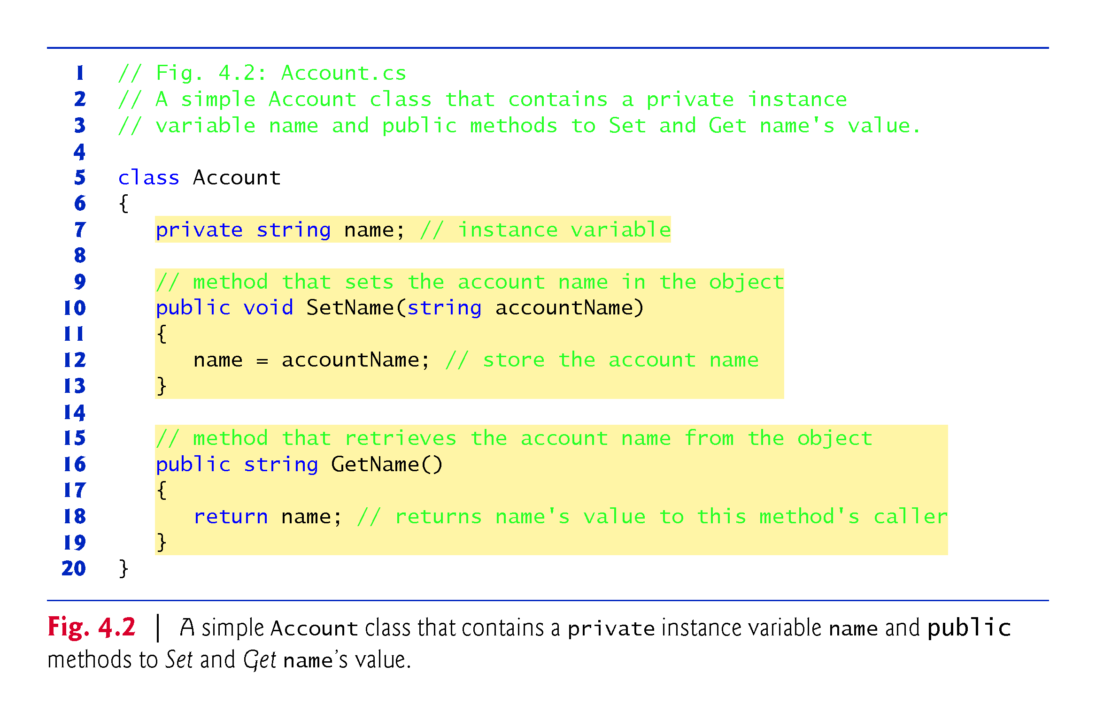

Slide 19
4.3.2 Keyword class and the Class Body
Every class declaration contains the keyword class followed immediately by the class’s name.
Each class declaration is typically stored in a file having the same name as the class and ending with the .cs filename extension;
The class’s body is enclosed in a pair of braces (lines 6 and 20).
Class, property, method and variable names are all identifiers and by convention all use the naming schemes we discussed in Chapter 3:
class, property and method names begin with an initial uppercase letter (Pascal case)
variable names begin with an initial lowercase letter (camel case).

Slide 20
4.3.3 Instance Variable name of Type string
Objects carry their instance variables with them throughout their lifetimes.
Each object has its own copy of the class’s instance variables.
A class’s methods and properties manipulate the instance variables belonging to particular objects of the class.
Instance variables are declared inside a class declaration but outside the bodies of the class’s methods and properties.

Slide 21
4.3.3 Instance Variable name of Type string
private string name; // instance variable
declares instance variable name of type string outside the bodies of methods SetName and GetName.
If there are many Account objects, each has its own name.
Because name is an instance variable, it can be manipulated by each of the class’s methods and properties.
Clients of class Account—that is, any other code that calls the class’s methods (such as class AccountTest’s Main)—cannot access the name instance variable because it’s declared private.
Clients can access Account’s public methods SetName and GetName.
These methods can access private instance variable name.

Slide 22
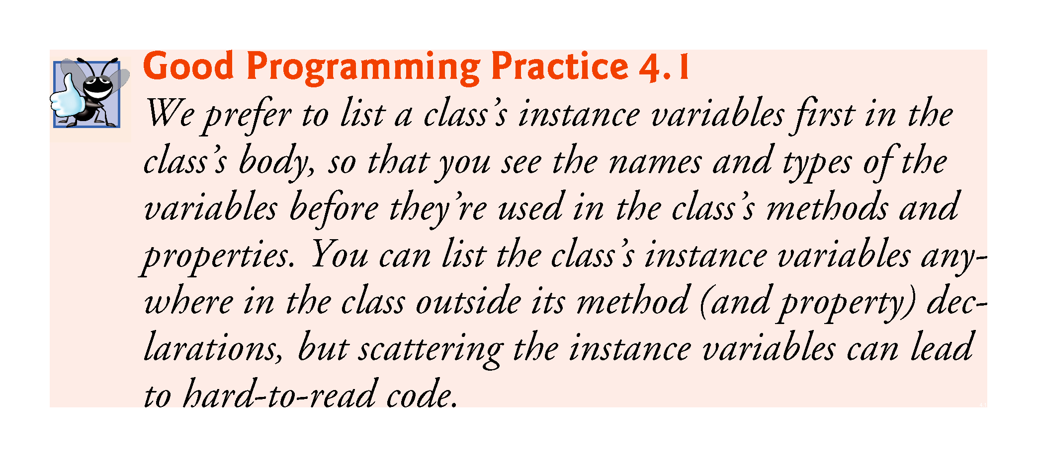

Slide 23
4.3.3 Instance Variable name of Type string
null—the Default Initial Value for string Variables
Every instance variable has a default initial value—a value provided by C# if you do not specify the instance variable’s initial value.
Thus, instance variables are not required to be explicitly initialized before they’re used in a program
unless they must be initialized to values other than their default values.
The default value for an instance variable of type string is null.
When you use Console.Write or Console.WriteLine to display a string variable that contains the value null, no text is displayed.

Slide 24
4.3.4 SetName Method
The first line of each method declaration (line 10) is the method header.
The method’s return type (which appears to the left of the method’s name) specifies the type of data the method returns to its caller after performing its task.
The return type void (line 10) indicates that when SetName completes its task, it does not return (i.e., give back) any information to its calling method—in this example, line 18 of the Main method.

Slide 25
4.3.4 SetName Method
Parameters represent the data it needs to perform its task.
Method SetName declares the string parameter accountName which receives the name that’s passed to SetName as an argument.
When SetName is called the argument value in the call’s parentheses is copied into the corresponding parameter (accountName) in the method’s header.

Slide 26
4.3.4 SetName Method
Parameters like accountName are declared in a parameter list located in the required parentheses following the method’s name.
Each parameter must specify a type followed by a parameter name.
When there are multiple parameters, they are placed in a comma-separated list.
The number and order of arguments in a method call must match the number and order of parameters in the method declaration’s parameter list.

Slide 27
4.3.4 SetName Method
Every method body is delimited by an opening left brace and a closing right brace.
Within the braces are one or more statements that perform the method’s task(s).
When program execution reaches the method’s closing brace, the method returns to its caller.

Slide 28
4.3.4 SetName Method
Variables declared in a particular method’s body (such as Main) are local variables which can be used only in that method.
Each method can access only its own local variables, not those of other methods.
When a method terminates, the values of its local variables are lost. A method’s parameters also are local variables of the method.

Slide 29
4.3.5 GetName Method
A method that has an empty parameter list does not require additional information to perform its task.
When a method with a return type other than void is called and completes its task, it must return a result to its caller.
The return statement passes the value of its expression back to the caller, which can then use the returned value.

Slide 30
4.3.6 Access Modifiers private and public
The keyword private is an access modifier.
Instance variable name is private to indicate that name is accessible only to class Account’s methods
and other members, like properties, as you’ll see in subsequent examples
This is known as information hiding.
Most instance variables are declared private.

Slide 31
4.3.6 Access Modifiers private and public
Methods (and other class members) that are declared public are “available to the public.”
They can be used
by methods (and other members) of the class in which they’re declared, and
by the class’s clients.
In Chapter 11, we’ll introduce the protected access modifier.
By default, everything in a class is private, unless you specify otherwise by providing access modifiers.

Slide 32
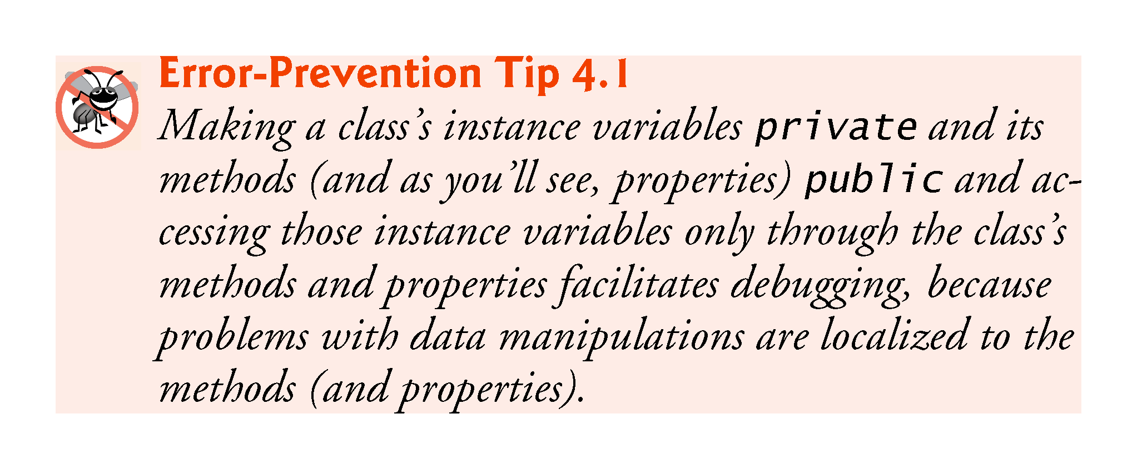

Slide 33
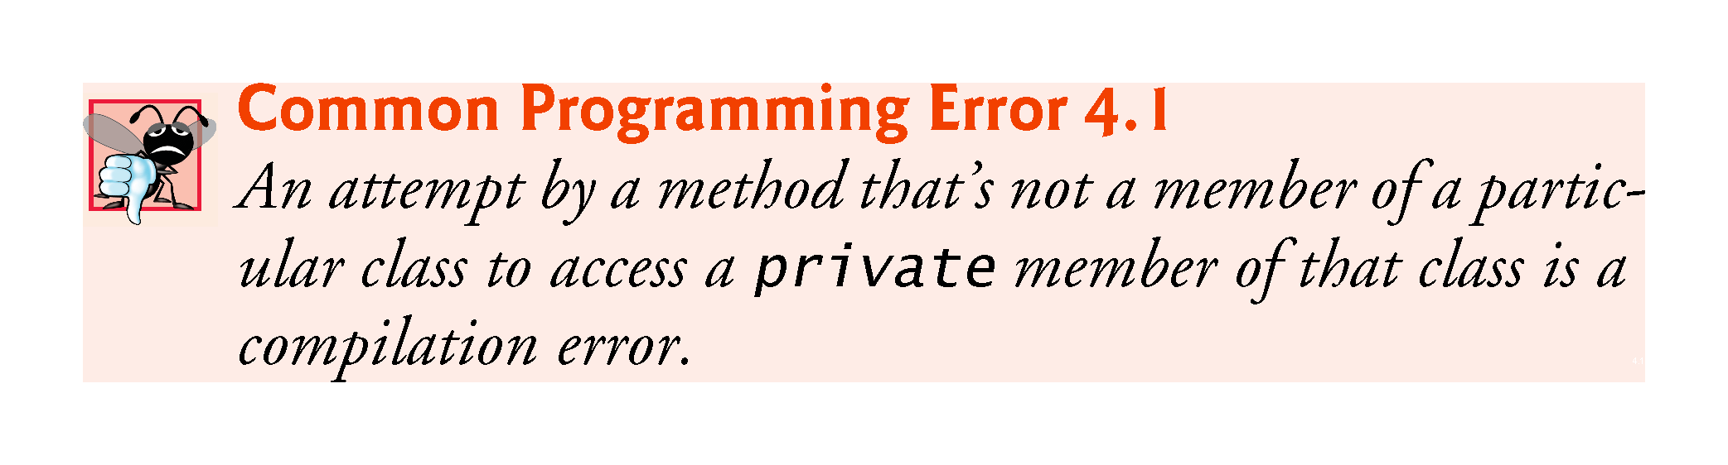

Slide 34
4.3.7 Account UML Class Diagram
UML diagrams help systems designers specify systems in a concise, graphical, programming-language-independent manner, before programmers implement the systems in specific programming languages.

Slide 35
4.3.7 Account UML Class Diagram
In the UML, each class is modeled in a class diagram as a rectangle with three compartments.
The top compartment contains the class name centered horizontally in boldface type.
The middle compartment contains the class’s attribute names, which correspond to the instance variables of the same names in C#.
private in C# is represented in the UML as a minus sign (–) UML access modifier.
Following an attribute’s name are a colon and the attribute type.

Slide 36
4.3.7 Account UML Class Diagram
The bottom compartment contains the class’s operations, which correspond to the methods of the same names in C#.
The UML models operations by listing the operation name preceded by a UML access modifier, for example, + SetName.
This plus sign (+) indicates that SetName is a public operation in the UML (because it’s a public method in C#).

Slide 37
4.3.7 Account UML Class Diagram
The UML indicates an operation’s return type by placing a colon and the return type after the parentheses following the operation name.
Method SetName does not return a value (because it returns void in C#), so the UML class diagram does not specify a return type after the parentheses of this operation.
The UML has its own data types similar to those of C#—for simplicity, we use the C# types.

Slide 38
4.3.7 Account UML Class Diagram
The UML models a parameter by listing the parameter name, followed by a colon and the parameter type in the parentheses after the operation name.

Slide 39
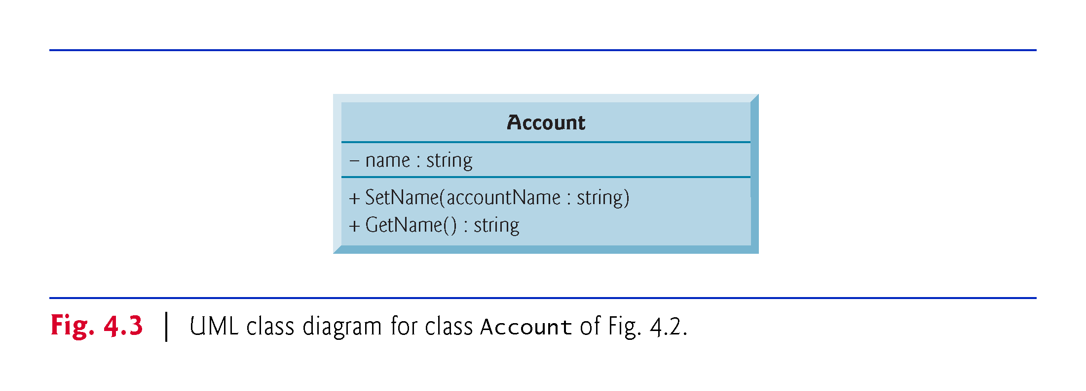

Slide 40
4.4 Creating, Compiling and Running a Visual C# Project with Two Classes
You must compile the classes in Figw. 4.1 and 4.2 before you can execute the app.
The IDE automatically recognizes as the app’s entry point the class that contains Main.
When you select Build > Build Solution in Visual Studio, the IDE compiles all the files in the project to create the executable app.
If both classes compile correctly—that is, no compilation errors are displayed—you can then run the app by typing Ctrl + F5.
If you do not build the app before running it, typing Ctrl + F5 will build the app first and run the app only if there are no compilation errors.

Slide 41
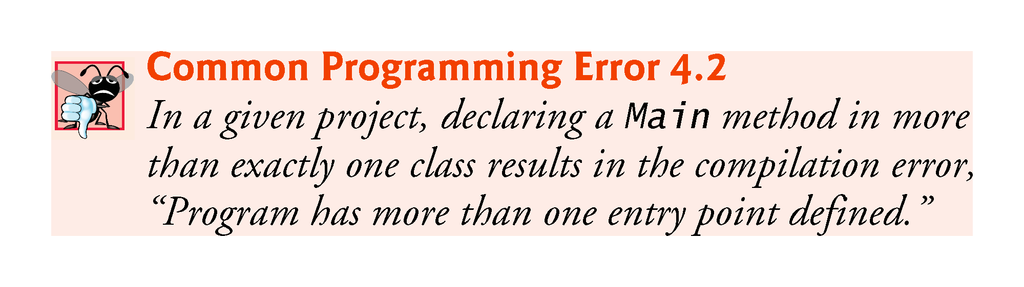

Slide 42
4.5 Software Engineering with Set and Get Methods
Set and Get methods can validate attempts to modify private data and control how that data is presented to the caller, respectively.
These are compelling software engineering benefits.
If an instance variable were public, any client of the class could see the data and modify it, including setting it to an invalid value.
Also, public data allows client-code programmers to write code that depends on the class’s data format.
If the class’s owner changes that format, any client code dependent on it would “break” and would need to be adjusted to the new format, making it subject to break again.

Slide 43
4.5 Software Engineering with Set and Get Methods
Set methods can be programmed to validate their arguments and reject any attempts to Set the data to bad values.
A Get method can present the data in a different form, while the actual data representation remains hidden from the user.
For example, a Grade class might store a grade instance variable as an int between 0 and 100, but a GetGrade method might return a letter grade as a string, such as "A" for grades between 90 and 100, "B" for grades between 80 and 89, …
Tightly controlling the access to and presentation of private data can greatly reduce errors, while increasing the robustness, security and usability of your programs.

Slide 44
4.5 Software Engineering with Set and Get Methods
Generally, instance variables should be private and methods public.

Slide 45
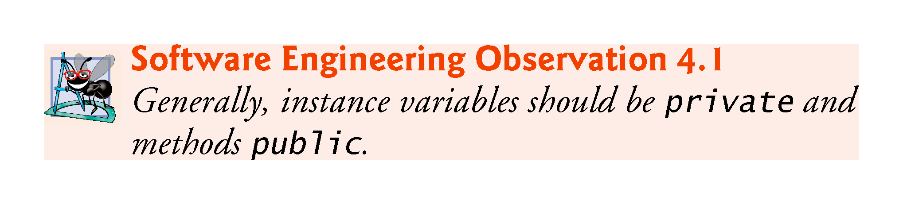

Slide 46
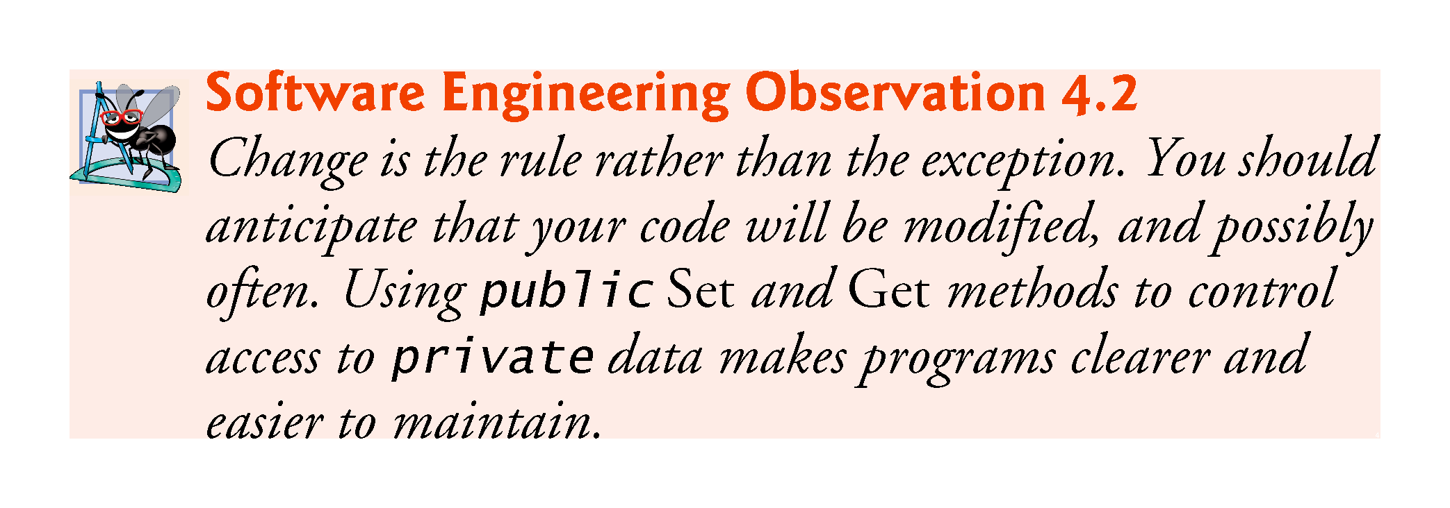

Slide 47
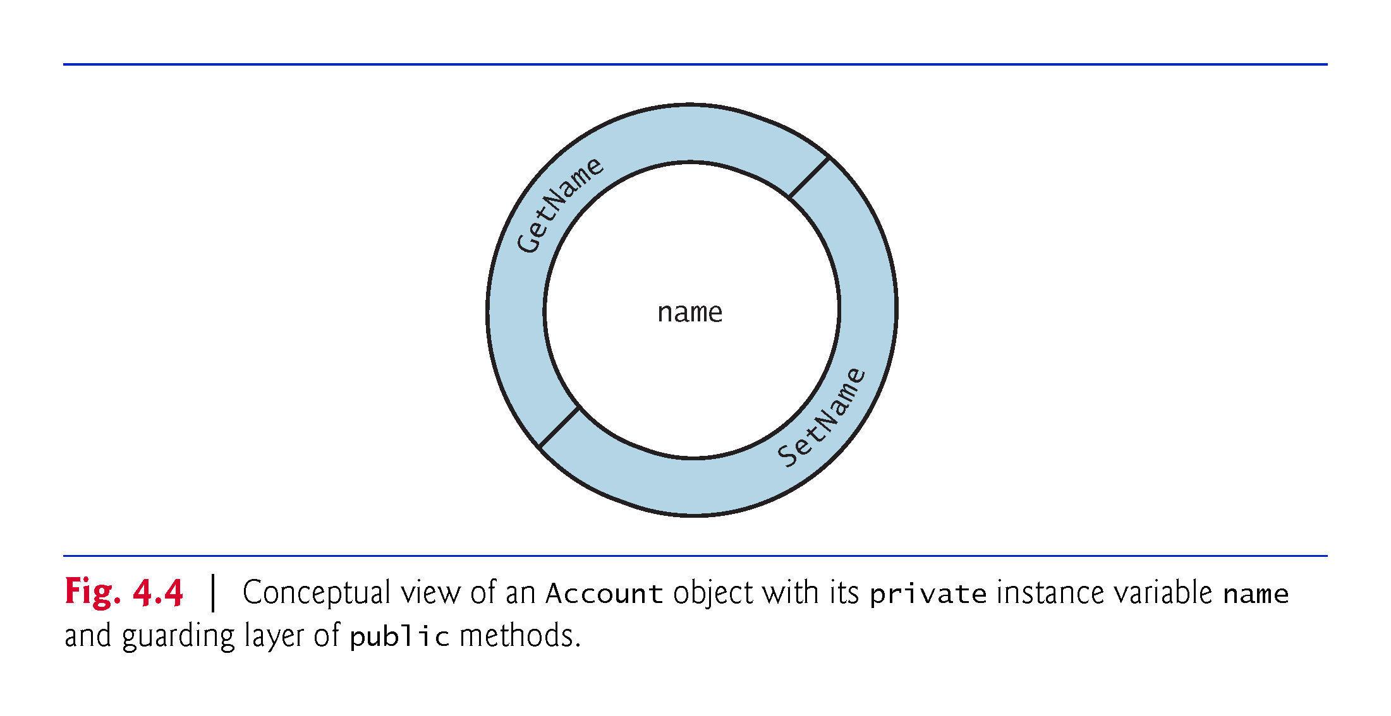

Slide 48
4.6 Account Class with a Property Rather Than Set and Get Methods
Our first Account class contained a private instance variable name and public methods SetName and GetName that enabled a client to assign to and retrieve from an Account’s name, respectively.
C# provides a more elegant solution—called properties—to accomplish the same tasks.
A property encapsulates a set accessor for storing a value into a variable and a get accessor for getting the value of a variable.

Slide 49
4.6.1 Class AccountTest Using Account’s Name Property
Fig. 4.5 shows the updated AccountTest class that uses class Account’s Name property (declared in Fig. 4.6) to get and set an Account’s name instance variable.

Slide 50
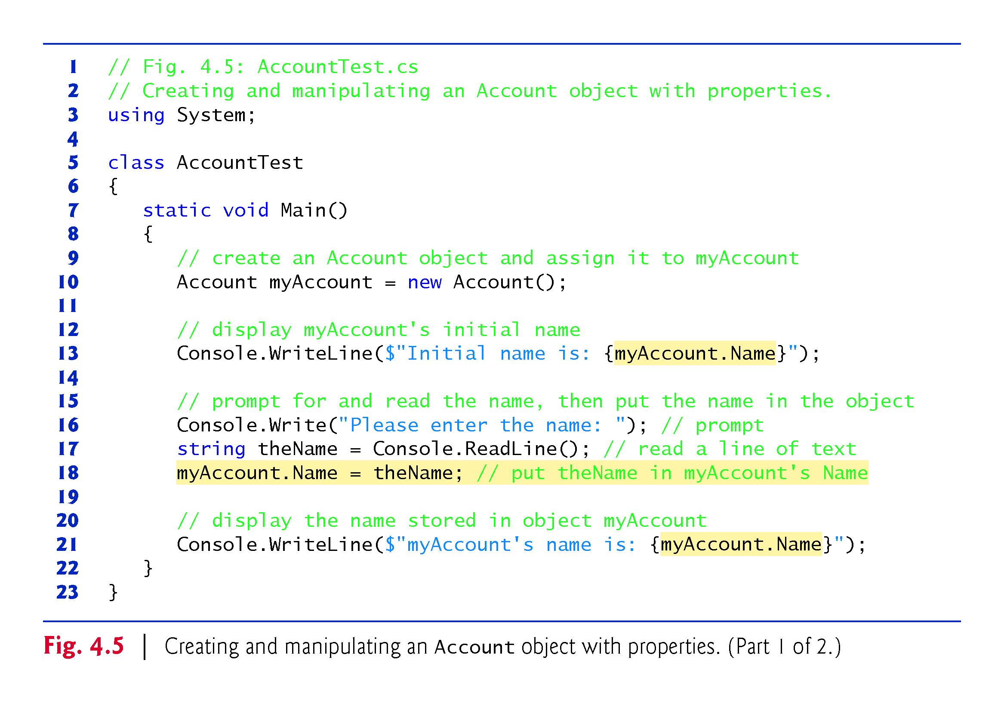

Slide 51
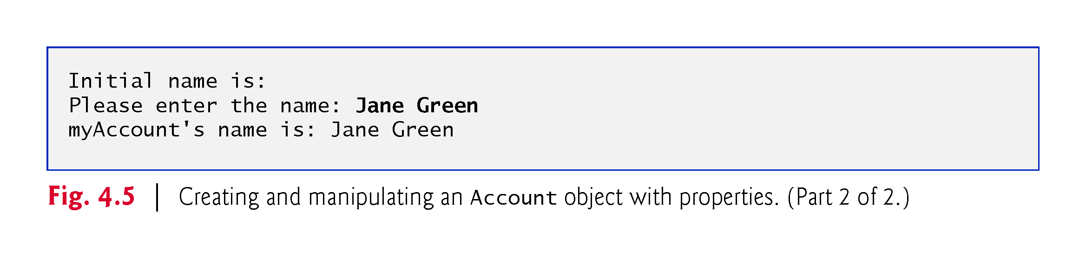

Slide 52
4.6.1 Class AccountTest Using Account’s Name Property
The get accessor of the Account class’s Name property gets the account name stored in a particular Account object.
myAccount.Name
To access a property, you specify the object’s name (myAccount), followed by the member-access operator (.) and the property’s name (Name).
When used to get the account’s name, this notation implicitly executes the property’s get accessor, which returns the account’s name.

Slide 53
4.6.1 Class AccountTest Using Account’s Name Property
When Main accesses the Name property in line 13
The app transfers execution from the expression myAccount.Name (line 13 in Main) to the property Name’s get accessor.
Next, the Name property’s get accessor performs its task—that is, it returns (i.e., gives back) the value of myAccount’s name instance variable to line 13 where the property was accessed.
Console.WriteLine displays the string returned by the Name property’s get accessor.

Slide 54
4.6.1 Class AccountTest Using Account’s Name Property
When property Name is invoked by the expression myAccount.Name on the left of an assignment
The app transfers program execution from line 18 in Main to Name’s set accessor.
Property Name’s set accessor performs its task—that is, it stores in the myAccount object’s name instance variable the string value that was assigned to property Name in Main (line 18).
When Name’s set accessor completes execution, program execution returns to where the Name property was accessed (line 18 in Main), then execution continues at line 21.

Slide 55
4.6.2 Account Class with an Instance Variable and a Property
The updated Account class replaces the GetName and SetName methods from Fig. 4.2 with the property Name (lines 10–20 of Fig. 4.6).
The property’s get and set accessors handle the details of getting and setting data, respectively.
Unlike method names, the accessor names get and set each begin with a lowercase letter.

Slide 56
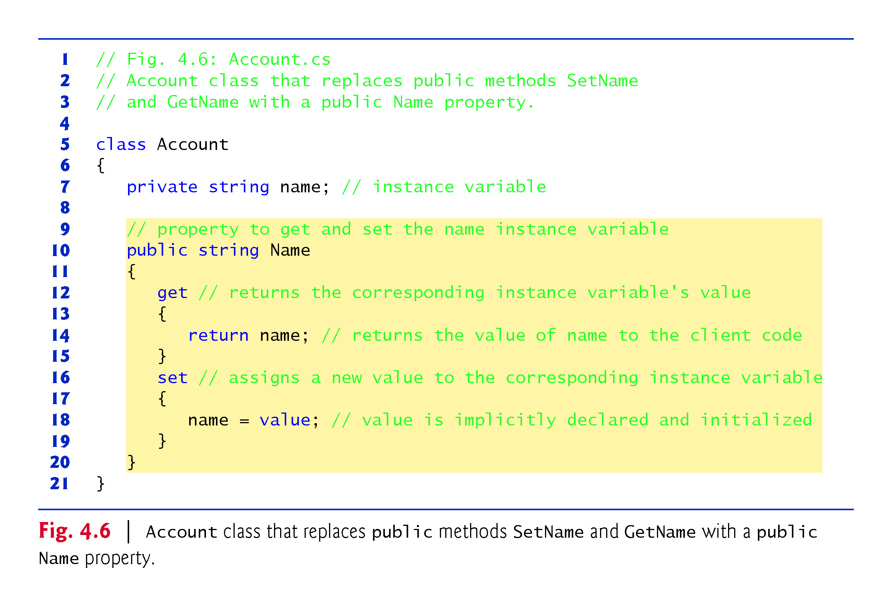

Slide 57
4.6.2 Account Class with an Instance Variable and a Property
public string Name
begins the Name property declaration, which specifies that
the property is public so it can be used by the class’s clients,
the property’s type is string and
the property’s name is Name.
By convention, a property’s identifier is the capitalized identifier of the instance variable that it manipulates
C# is case sensitive, so Name and name are distinct identifiers.
The property’s body is enclosed in braces.

Slide 58
4.6.2 Account Class with an Instance Variable and a Property
A get accessor begins with the keyword get, and its body is delimited by braces
A get accessor’s body contains a return statement that typically returns the value of an instance variable.
The property notation myAccount.Name allows the client to think of the property as the underlying data, but the client still cannot directly manipulate the private instance variable name.
Keyword get is a contextual keyword, because it’s a keyword only in a property’s context (that is, its body)—in other contexts, get can be used as an identifier.

Slide 59
4.6.2 Account Class with an Instance Variable and a Property
A set accessor begins with the identifier set followed by its body, which is delimited by braces.
A set accessor uses the keyword value as its parameter.
value is implicitly declared and initialized for you with the value that the client code assigns to the property.
Like get, the keywords set and value are contextual keywords
set is a keyword only in a property’s context
value is a keyword only in a set accessor’s context

Slide 60
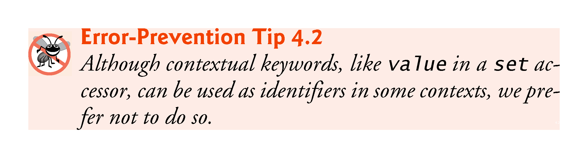

Slide 61
4.6.3 Account UML Class Diagram with a Property
We model C# properties in the UML as attributes.
A property is followed by the word “property” in guillemets (« and »).
Using descriptive words in guillemets (called stereotypes in the UML) helps distinguish properties from other attributes and operations.
The UML indicates the type of a property by placing a colon and a type after the property name.

Slide 62
4.6.3 Account UML Class Diagram with a Property
A class diagram helps you design a class, so it’s not required to show every implementation detail.
Since an instance variable that’s manipulated by a property is really an implementation detail of that property, our class diagram does not show the corresponding instance variable.
A programmer implementing the class based on a class diagram would create the instance variables as part of the implementation process.
Similarly, a property’s get and set accessors are implementation details, so they’re not listed in the UML diagram.

Slide 63
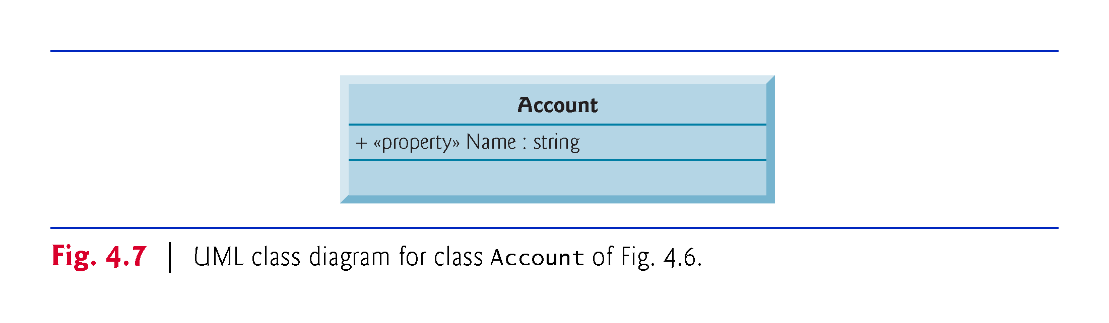

Slide 64
4.7 Auto-Implemented Properties
When a property’s get accessor simply returns private instance variable value and its set accessor simply assigns a value to the instance variable you can use an auto-implemented property.
The C# compiler automatically creates a hidden private instance variable, and the get and set accessors for getting and setting that hidden instance variable.
This enables you to implement the property trivially, which is handy when you’re first designing a class.

Slide 65
4.7 Auto-Implemented Properties
To use an auto-implemented property in the Account class, you’d replace the private instance variable and the separate property with the following single line of code:
public string Name { get; set; }

Slide 66
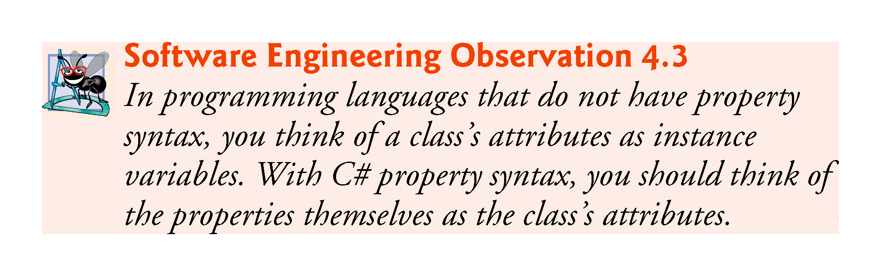

Slide 67
4.8 Account Class: Initializing Objects with Constructors
Each class you declare optionally can provide a constructor with parameters that can be used to initialize an object when it’s created.
C# requires a constructor call for every object that’s created, so this is the ideal point to initialize an object’s instance variables.

Slide 68
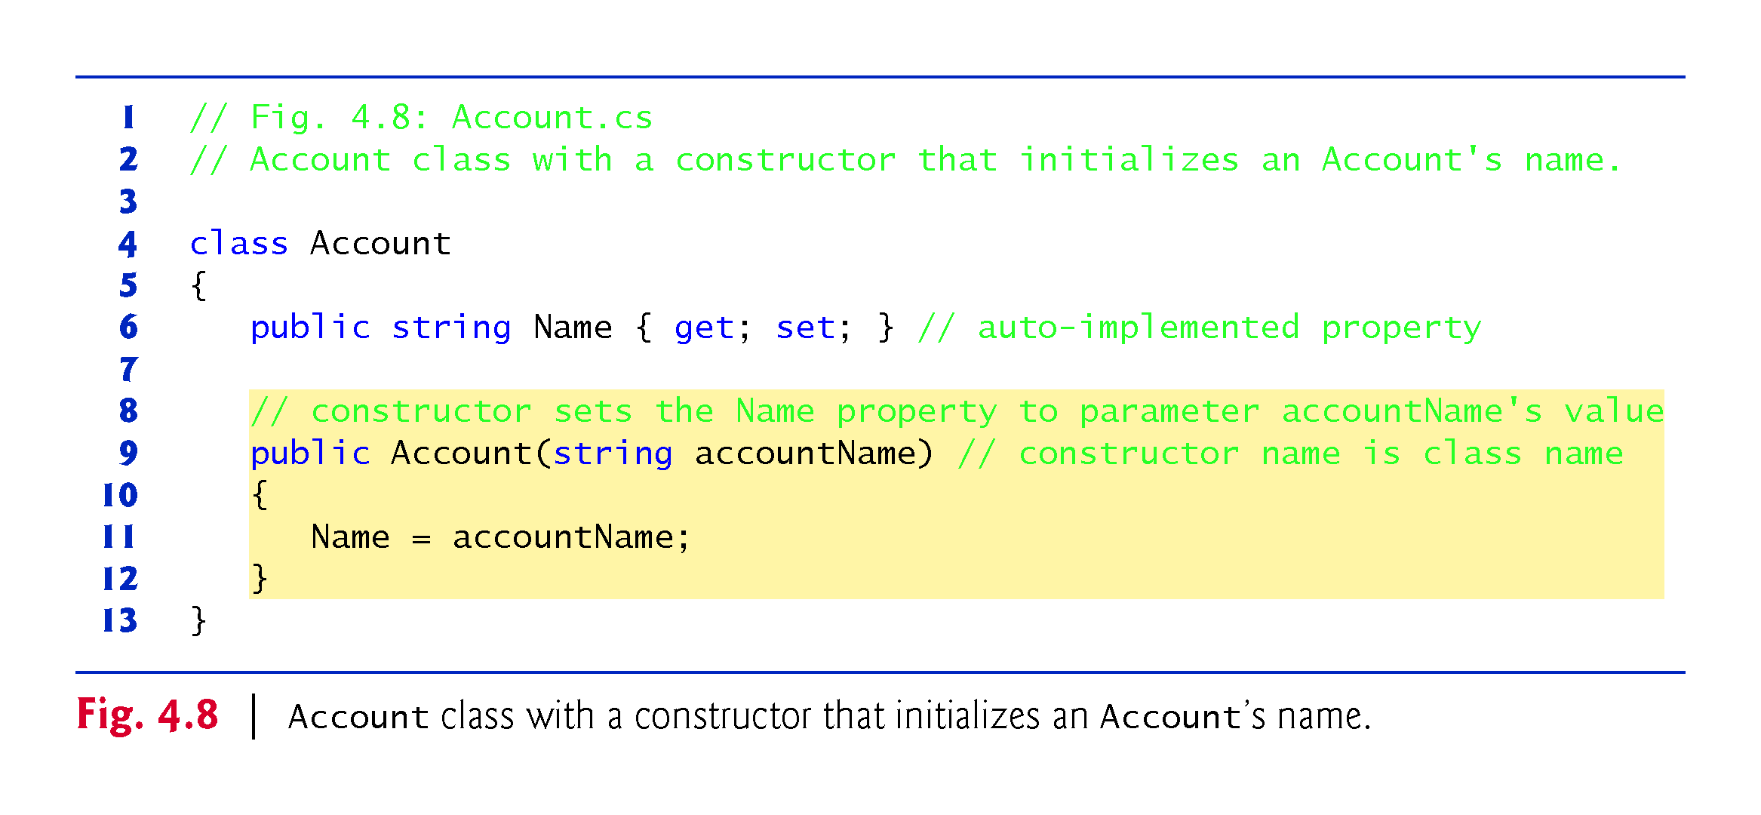

Slide 69
4.8.1 Declaring an Account Constructor for Custom Object Initialization
When you declare a class, you can provide your own constructor to specify custom initialization for objects of your class.
Account account1 = new Account("Jane Green");
In this case, the string argument "Jane Green" is passed to the Account object’s constructor and used to initialize the Account’s name.
A constructor’s identifier must be the class’s name.
The preceding statement requires an Account constructor that can receive a string.

Slide 70
4.8.1 Declaring an Account Constructor for Custom Object Initialization
An important difference between constructors and methods is that constructors cannot specify a return type (not even void).
Normally, constructors are declared public so they can be used by the class’s client code to initialize objects of the class.
A constructor’s body is delimited by a pair of containing one or more statements that perform the constructor’s task(s).

Slide 71
4.8.2 Class AccountTest: Initializing Account Objects When They’re Created
Keyword new requests memory from the system to store an object, then implicitly calls the class’s constructor to initialize the object.
The call is indicated by the parentheses after the class name.

Slide 72
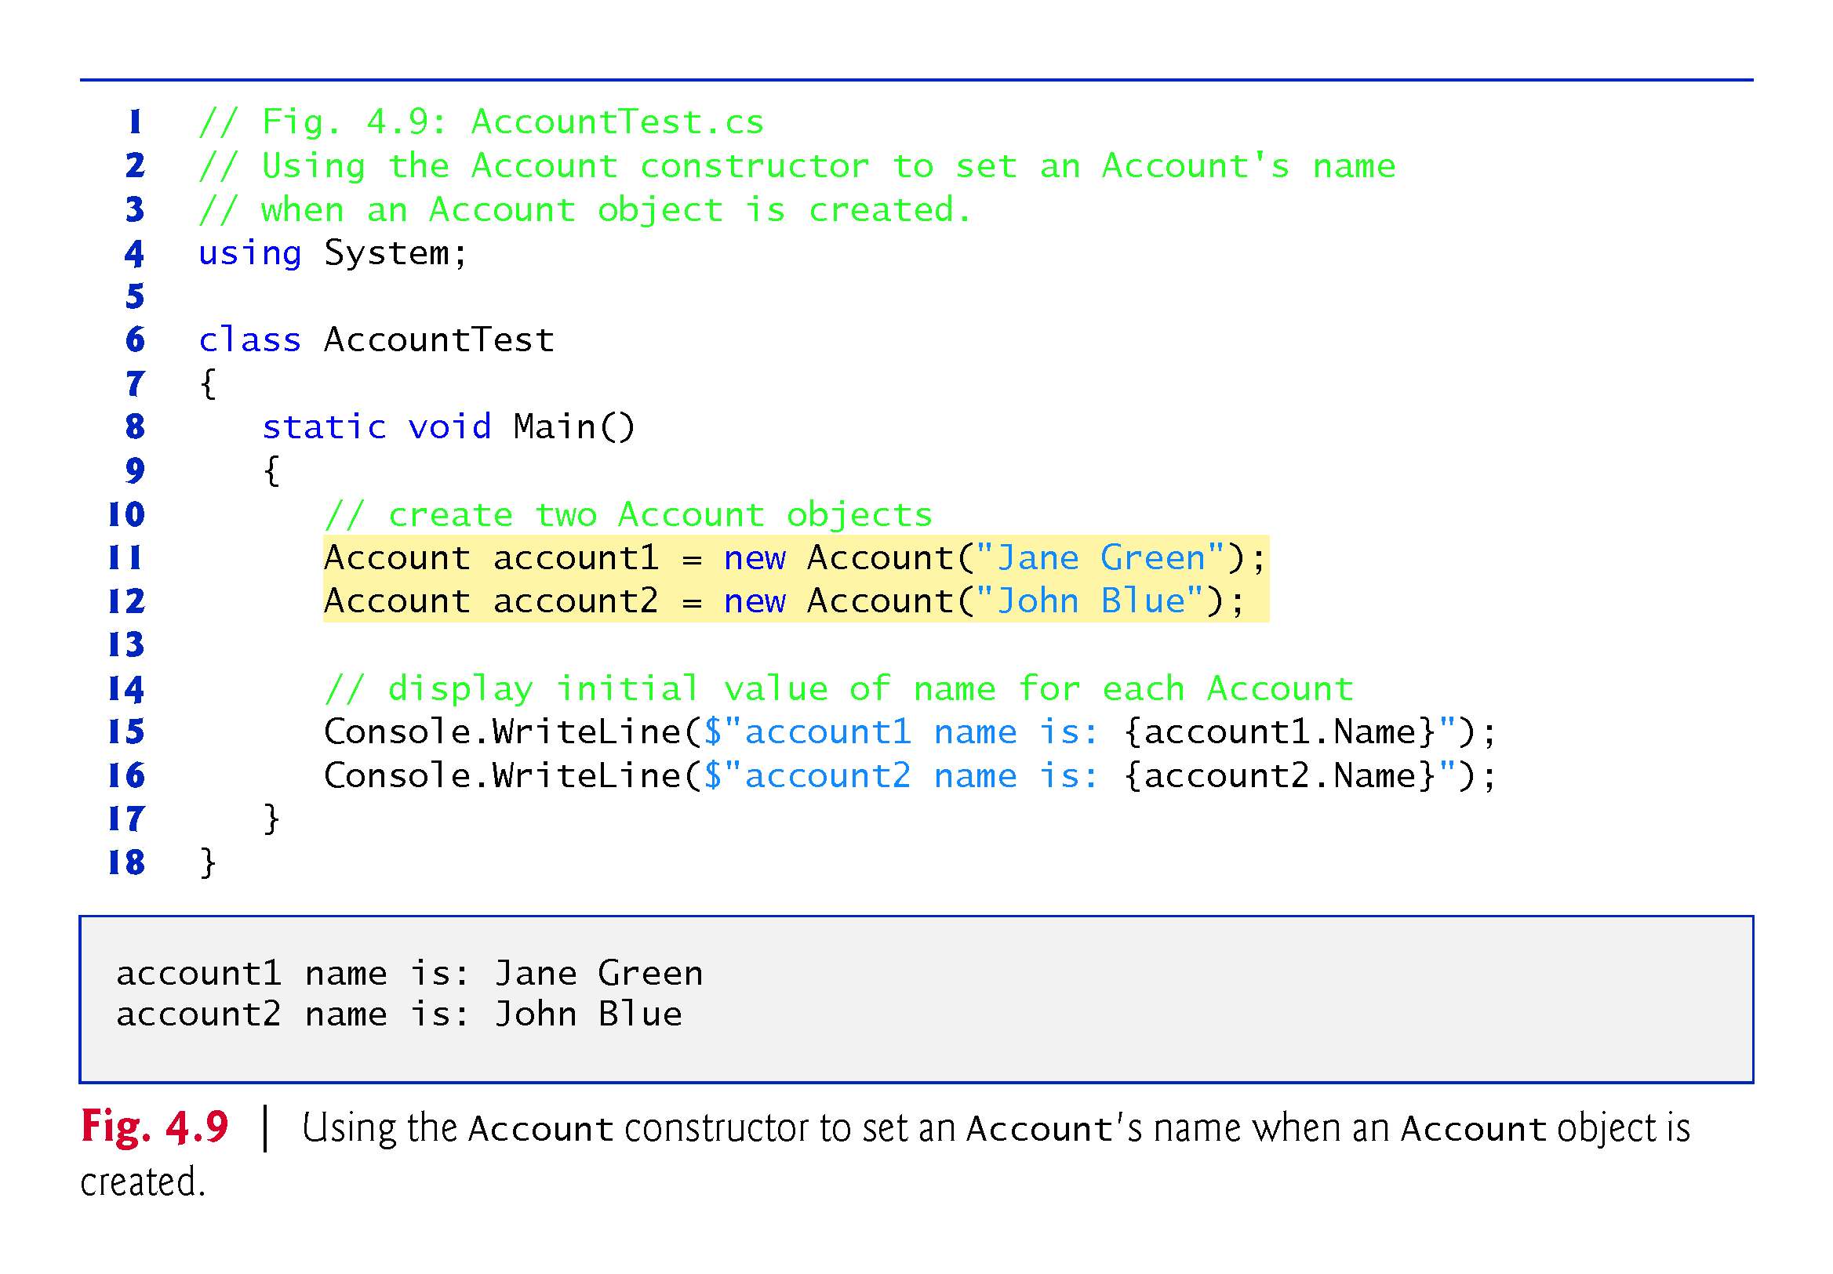

Slide 73
4.8.2 Class AccountTest: Initializing Account Objects When They’re Created
The empty parentheses in the expression new Account() indicate a call to the class’s default constructor
In any class that does not explicitly declare a constructor, the compiler provides a public default constructor (which always has no parameters).
When a class has only the default constructor, the class’s instance variables are initialized to their default values:
0 for numeric simple types,
false for simple type bool and
null for all other types.

Slide 74
4.8.2 Class AccountTest: Initializing Account Objects When They’re Created
If you declare one or more constructors for a class, the compiler will not create a default constructor for that class.

Slide 75
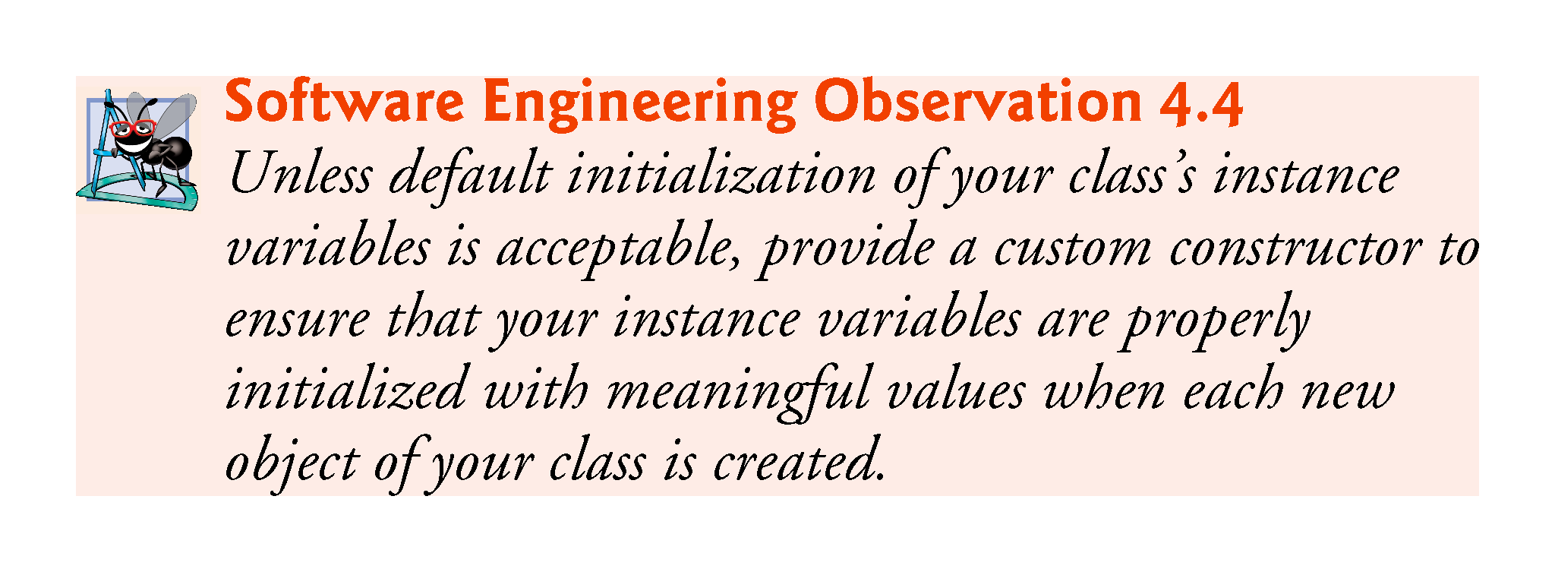

Slide 76
4.8.2 Class AccountTest: Initializing Account Objects When They’re Created
The UML models constructors as operations in the third compartment of a class diagram.
To distinguish a constructor from the class’s other operations, the UML requires that the word “constructor” be enclosed in guillemets (« and ») and placed before the constructor’s name.
It’s customary to list constructors before other operations in the third compartment.

Slide 77
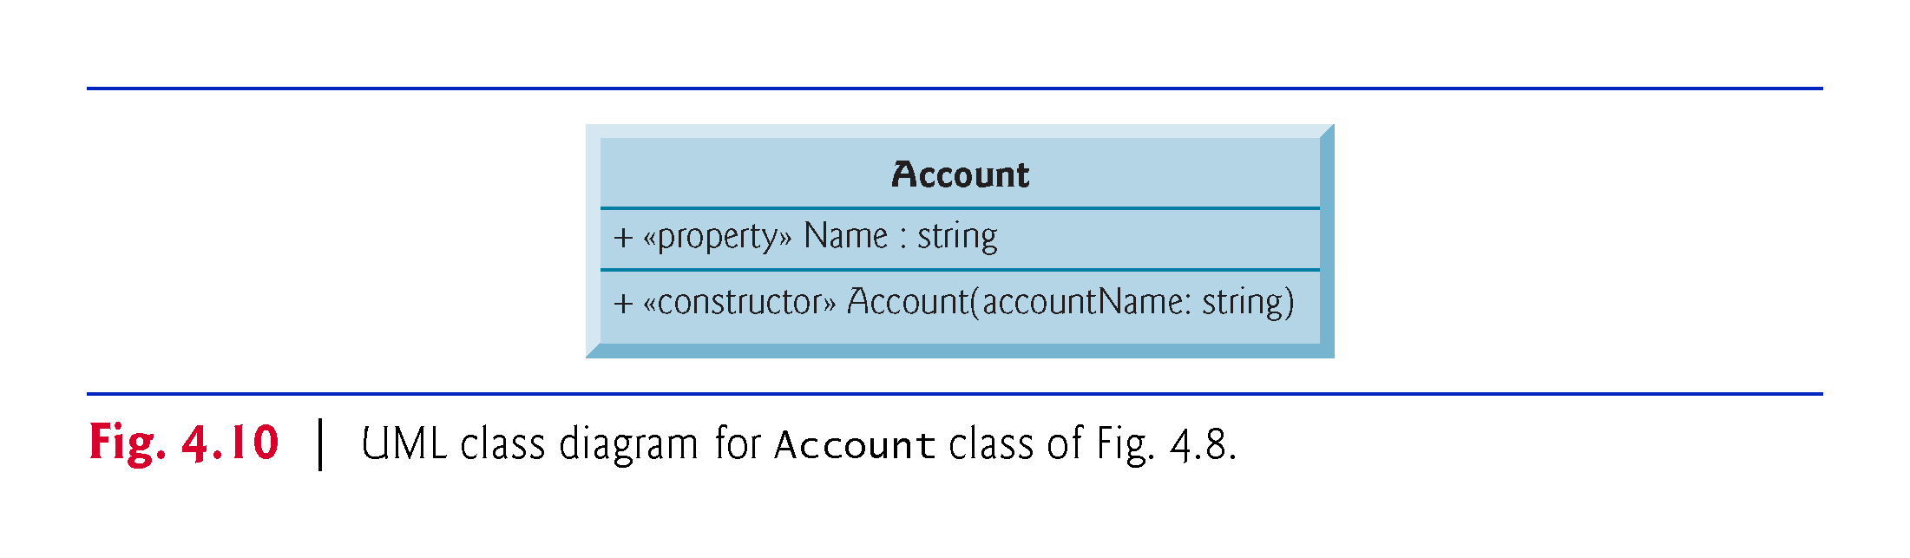

Slide 78
4.9 Account Class with a Balance; Processing Monetary Amounts
Type decimal is designed to precisely represent numbers with decimal points, especially monetary amounts.

Slide 79
4.9.1 Account Class with a decimal balance Instance Variable
A decimal instance variable is initialized to zero by default.
The Balance property’s set accessor performs validation (also known as validity checking).
In 0.0m the letter m (or M) indicates that 0.0 is a decimal literal.
The m is required to indicate a decimal literal.
C# treats numeric literals with decimal points as type double by default, and doubles and decimals cannot be intermixed.

Slide 80
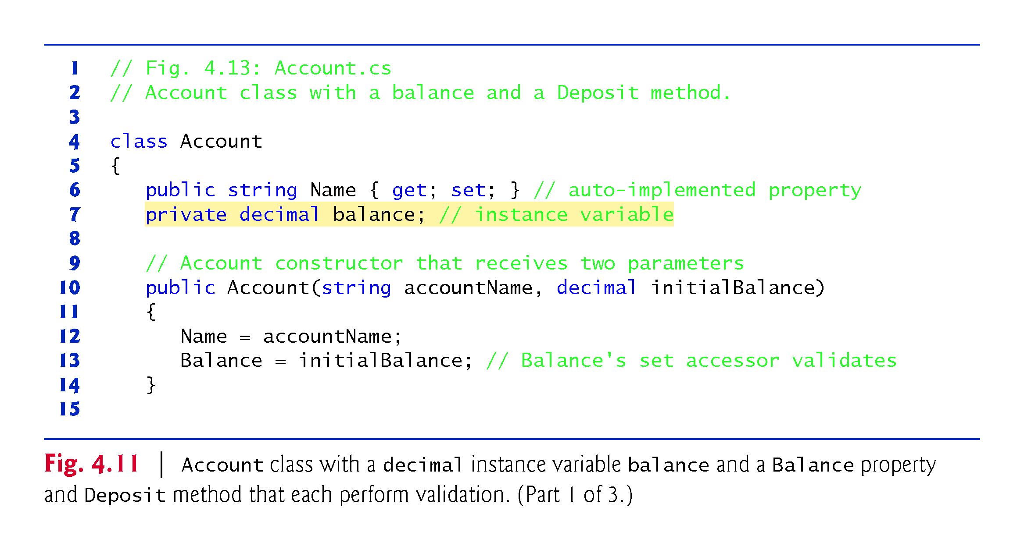

Slide 81
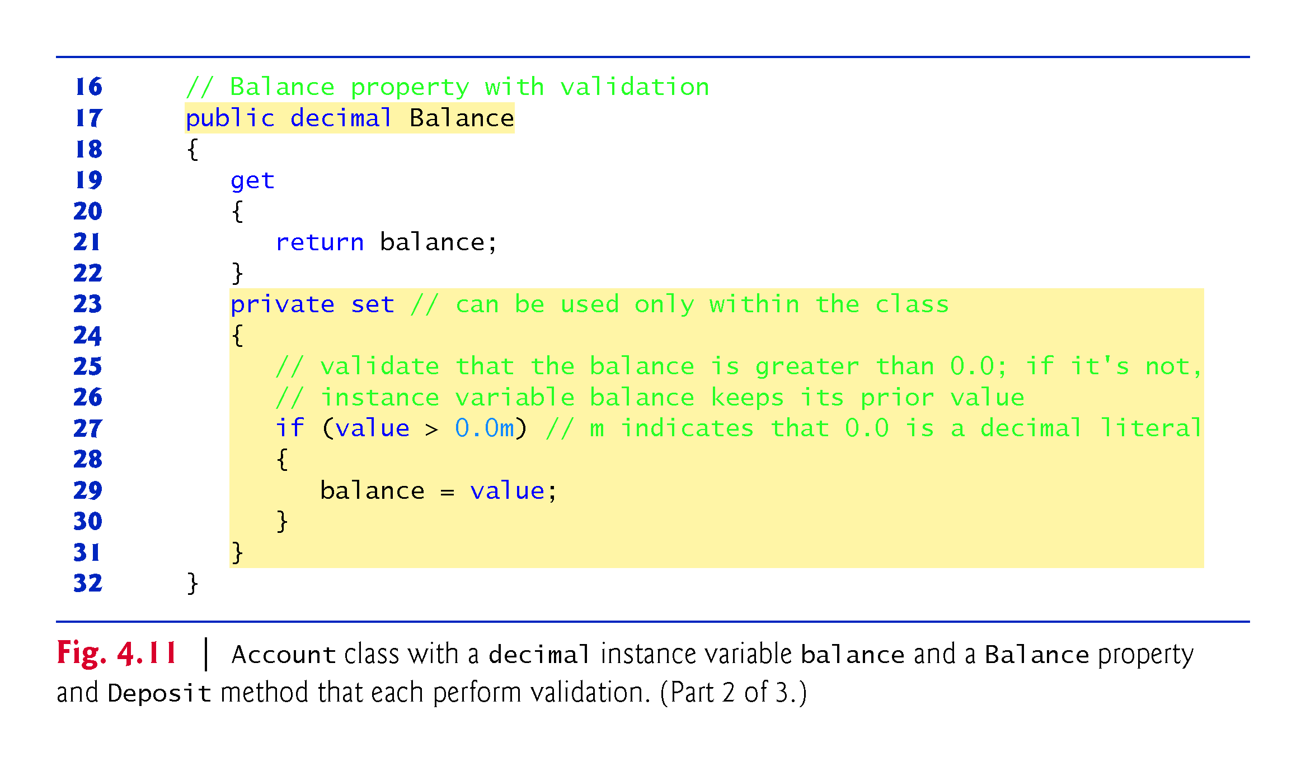

Slide 82
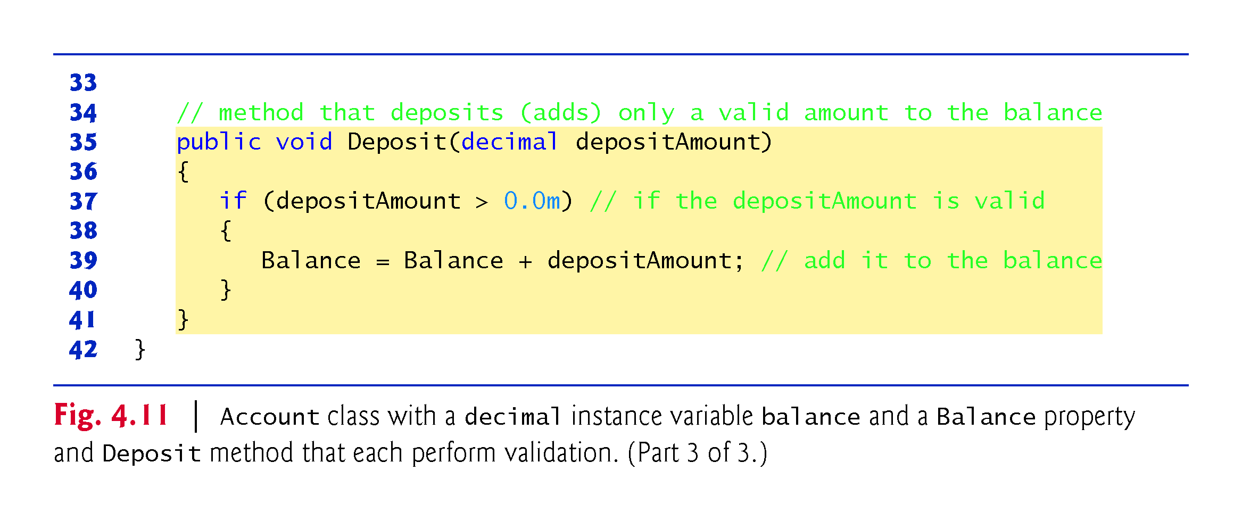

Slide 83
4.9.1 Account Class with a decimal balance Instance Variable
By default, a property’s get and set accessors have the same access as the property—e.g., a public property accessors are public.
It’s possible to declare the get and set accessors with different access modifiers.
In this case, one of the accessors must implicitly have the same access as the property and the other must be explicitly declared with a more restrictive access modifier than the property.
We declared the Balance property’s set accessor private
indicates that it may be used only in class Account.
enables us to ensure that once an Account object exists, its balance can be modified only by method Deposit

Slide 84
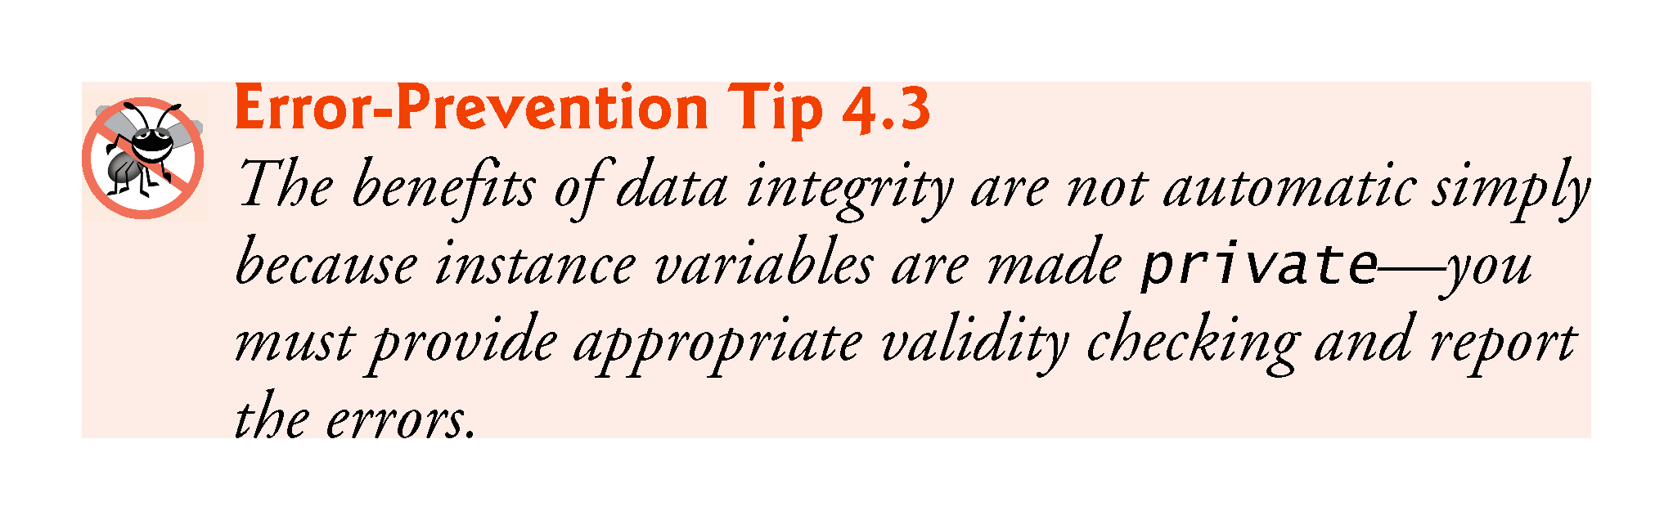

Slide 85
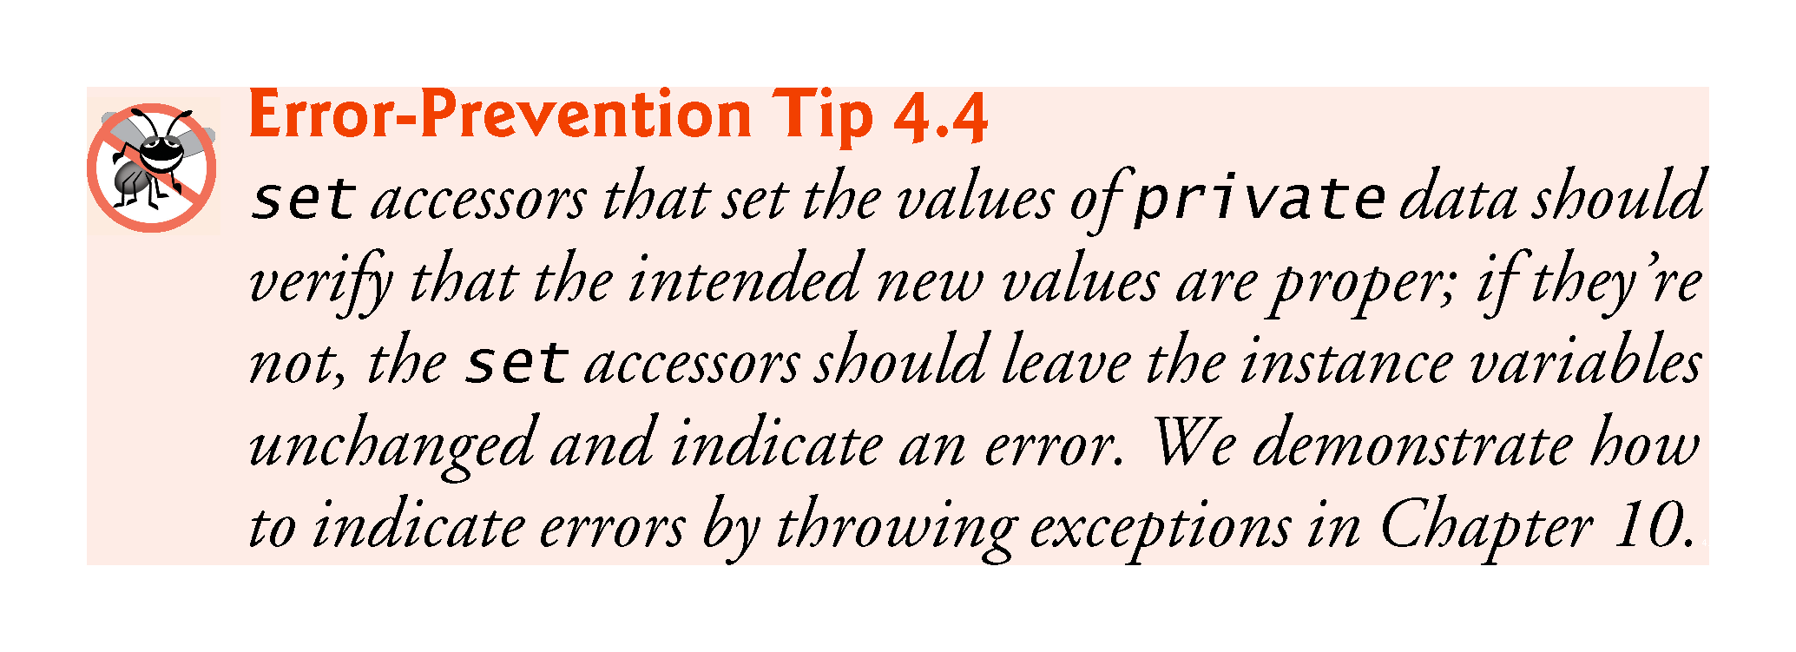

Slide 86
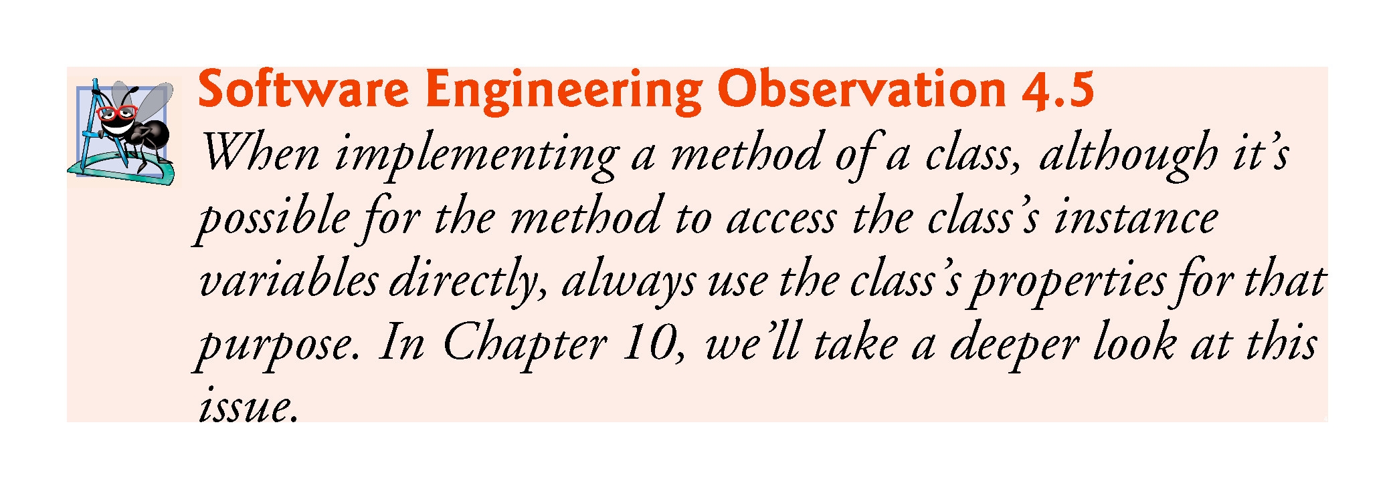

Slide 87
4.9.2 AccountTest Class That Uses Account Objects with Balances
You can specify formatting in a C# 6 string interpolation expression by following the value in the braces with a colon and a format specifier.
{account1.Balance:C}
uses the format specifier C to format account1.Balance as currency.
The Windows culture settings on the user’s machine determine the format for displaying currency amounts, such as the commas vs. periods for separating thousands, millions, etc.

Slide 88
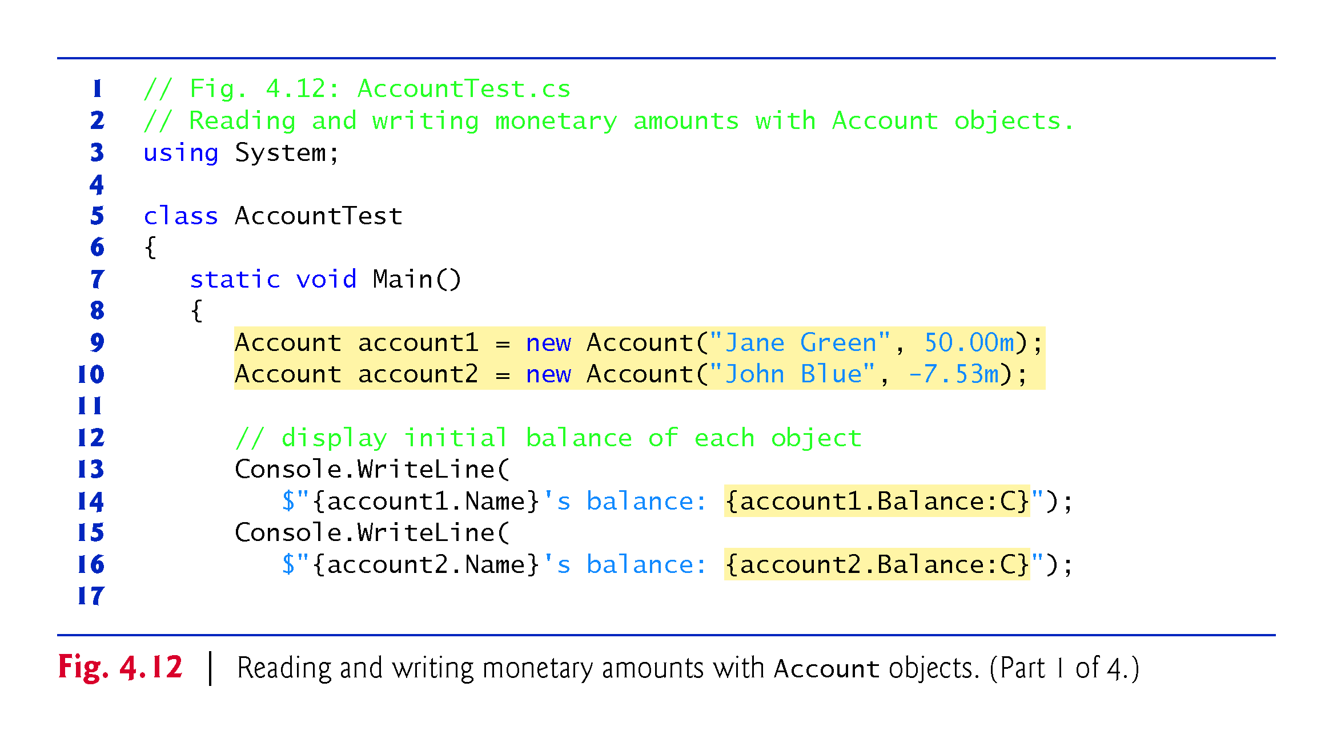

Slide 89
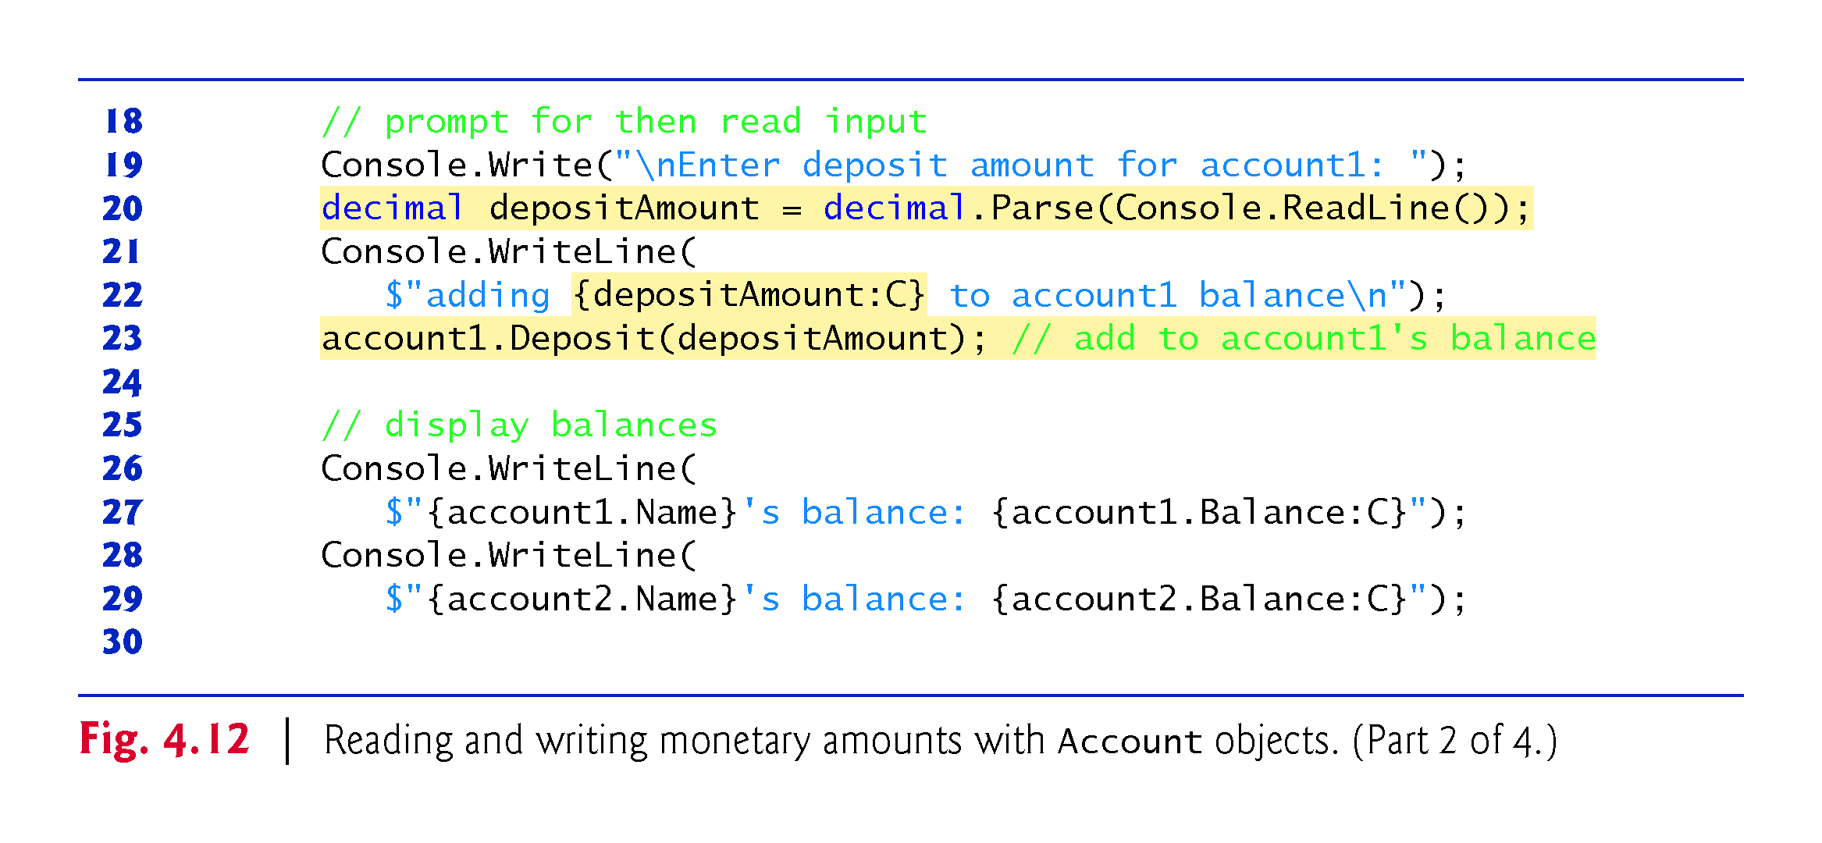

Slide 90
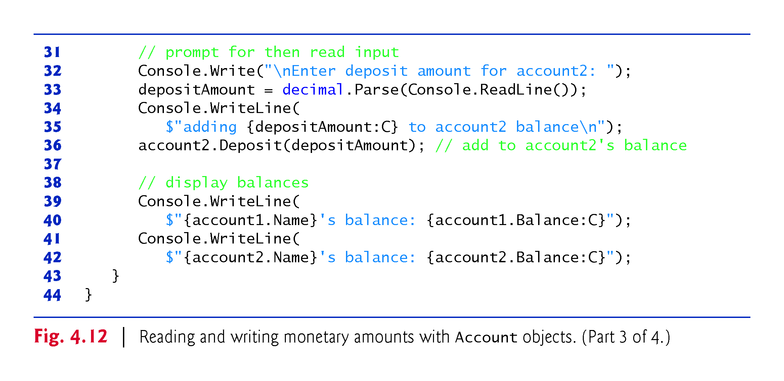

Slide 91
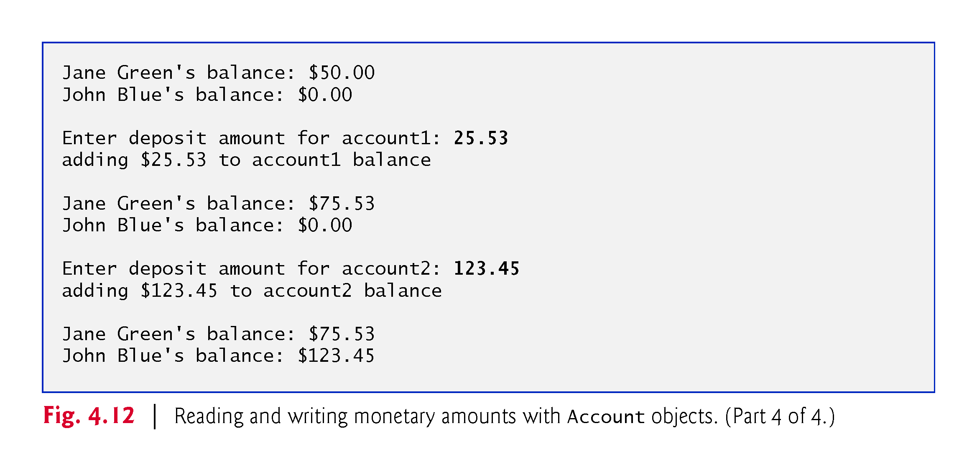

Slide 92
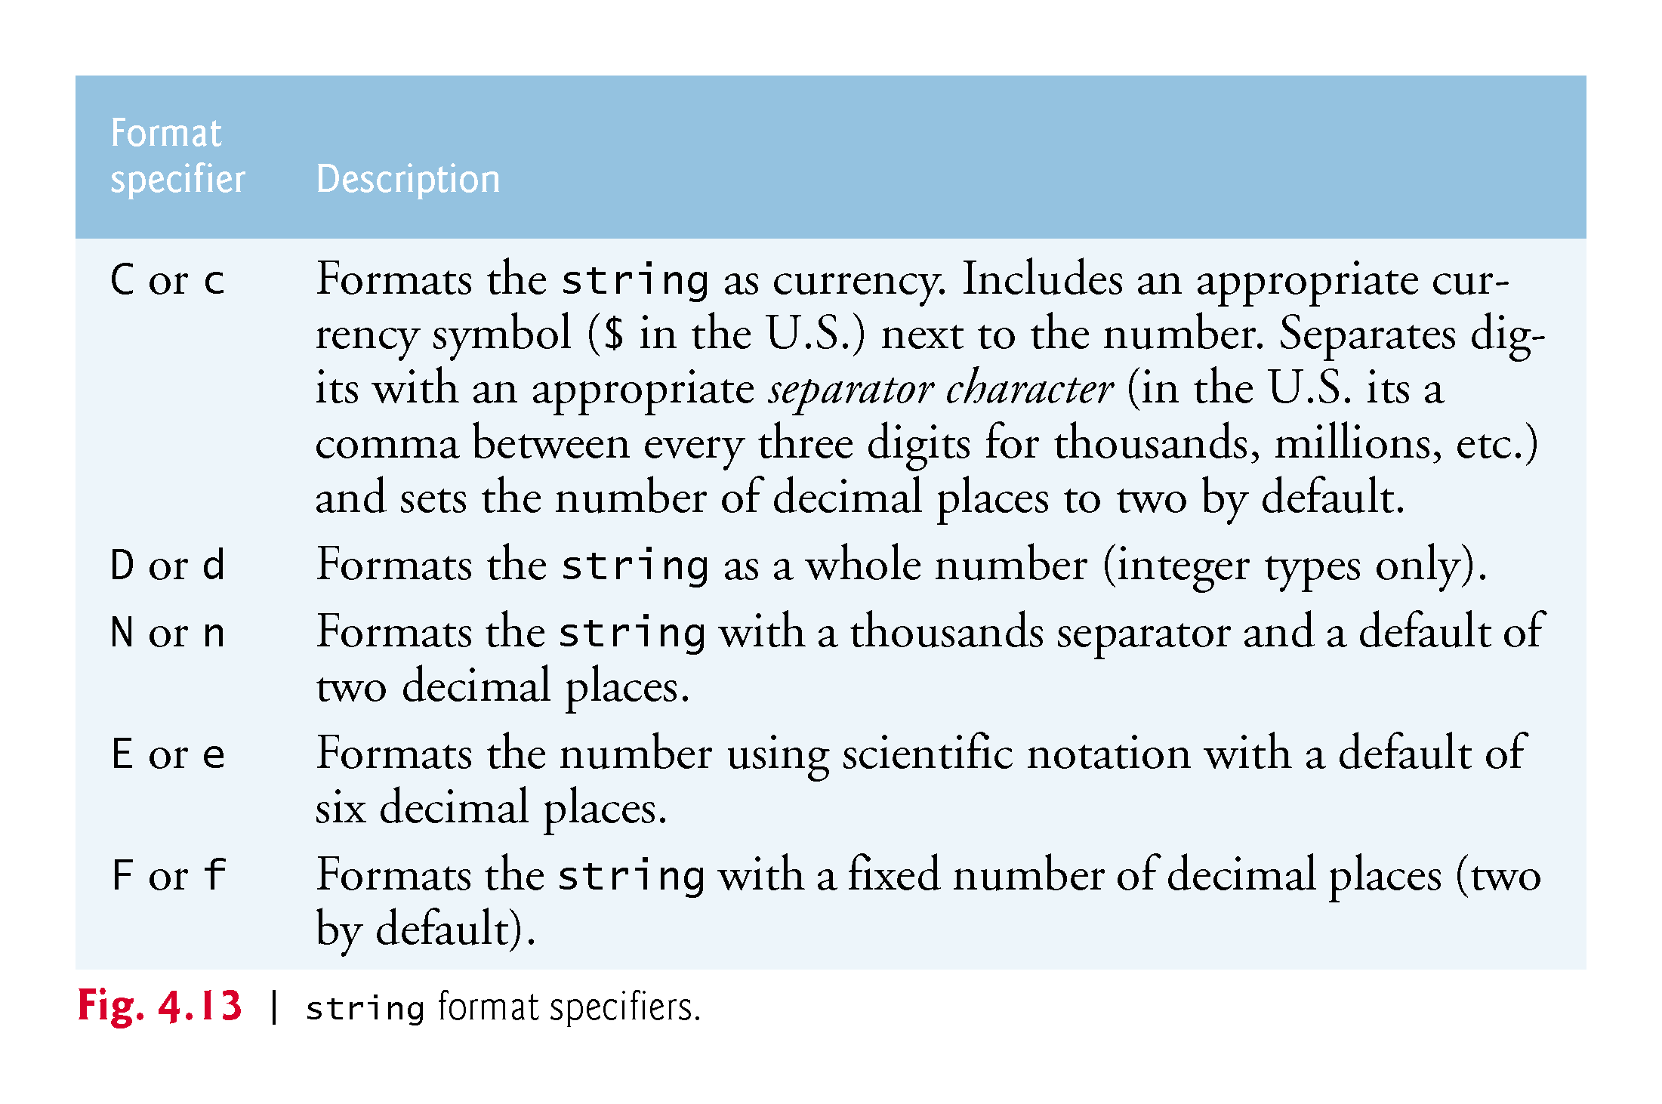

Slide 93
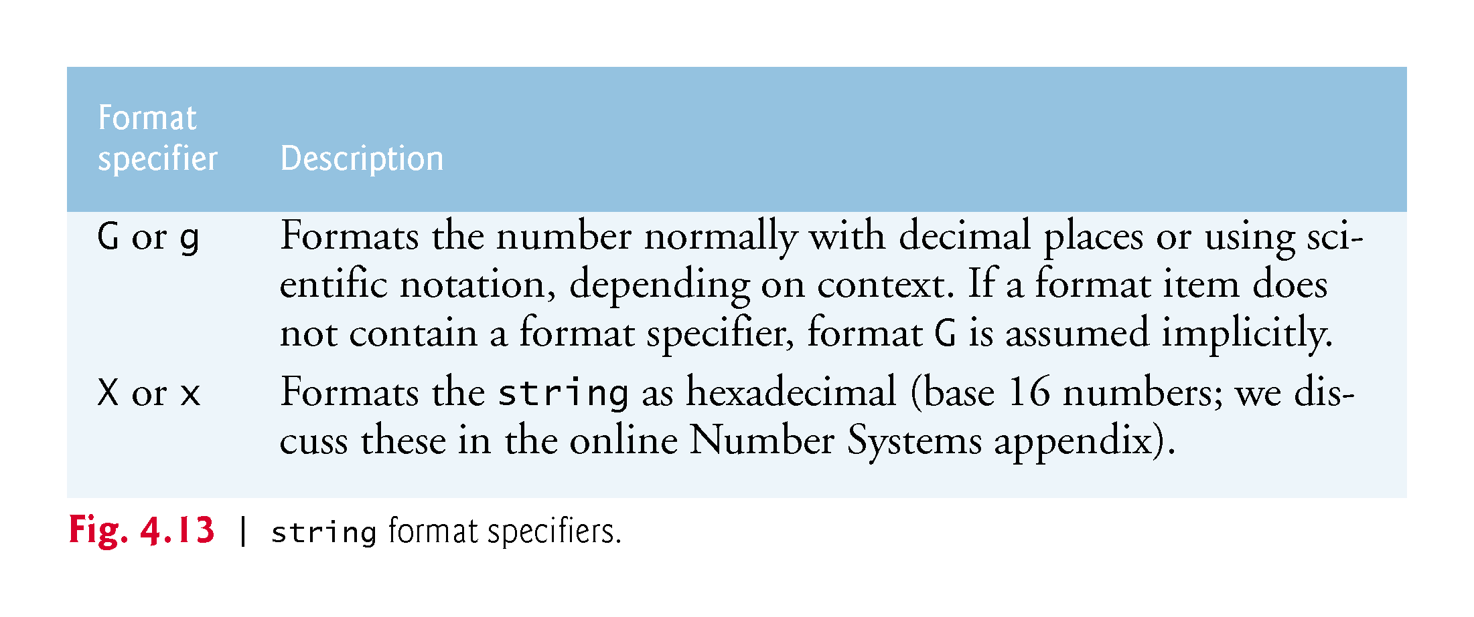

Slide 94
4.9.2 AccountTest Class That Uses Account Objects with Balances
Unlike instance variables, local variables are not initialized by default, so they normally must be initialized explicitly.
decimal’s Parse method returns the decimal value in this string—each simple type has a Parse method.

Slide 95
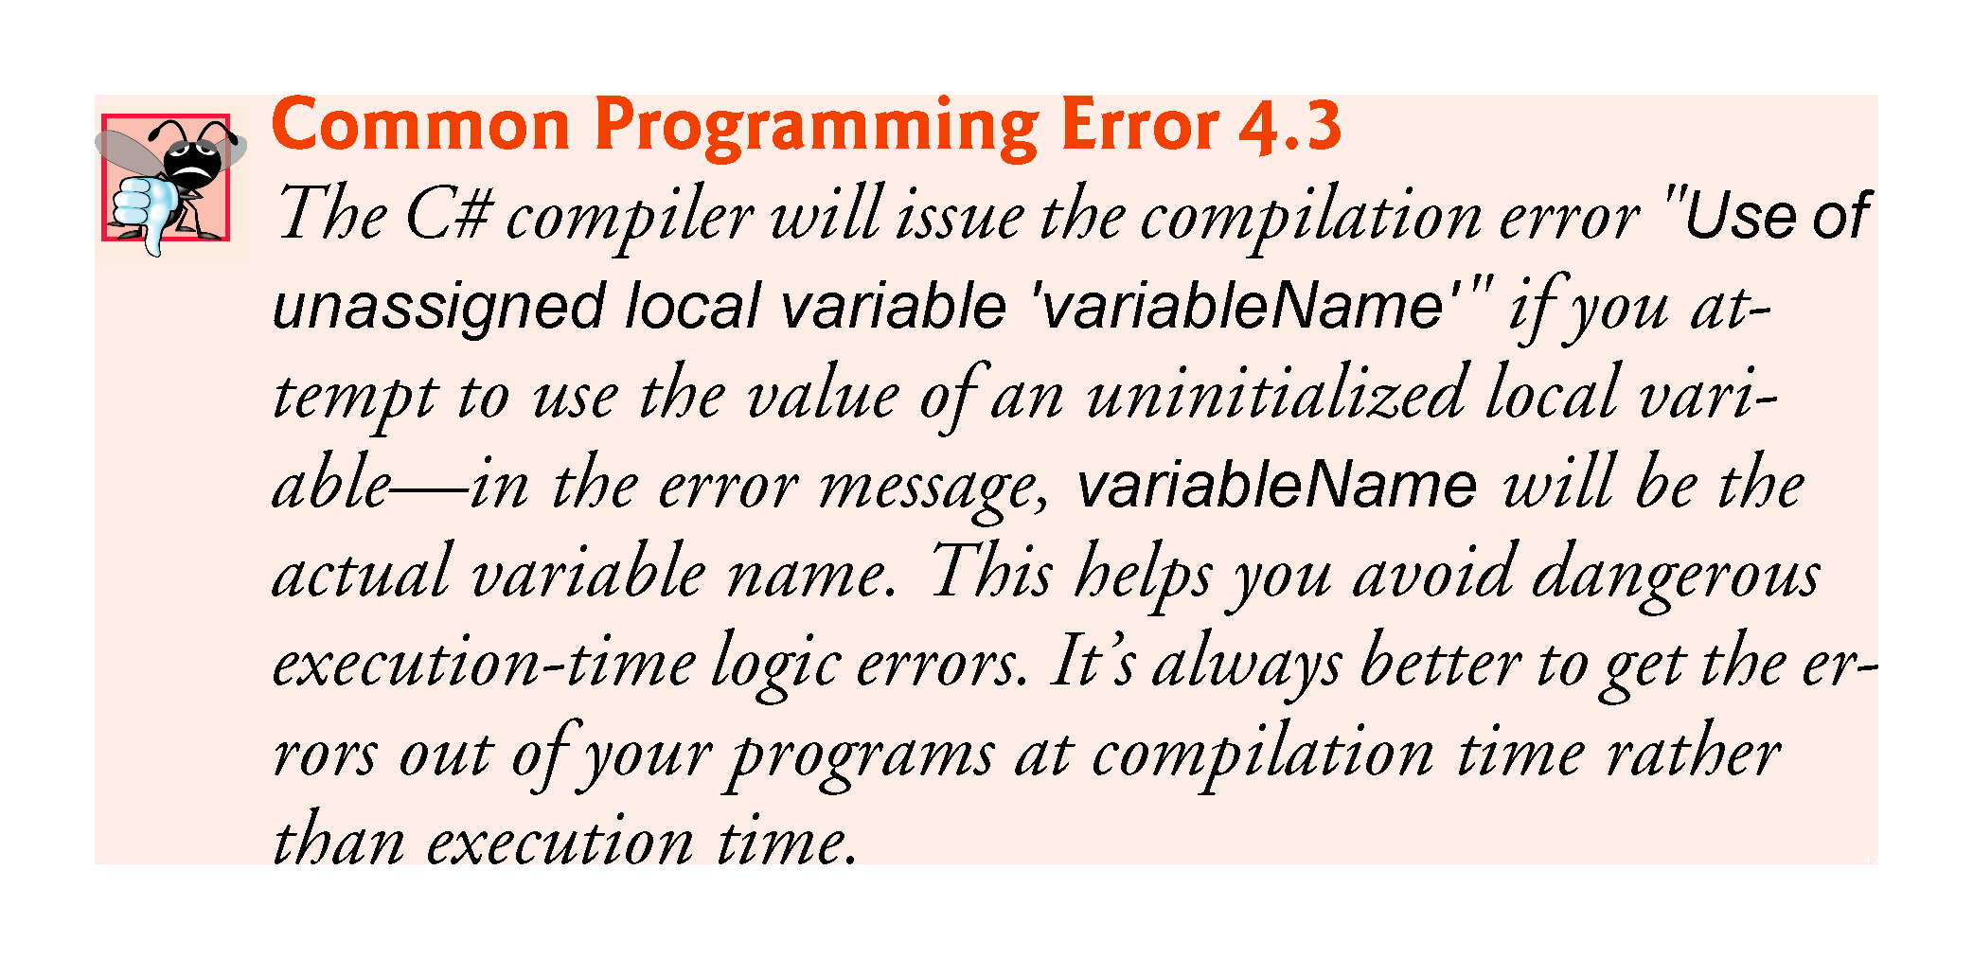

Slide 96
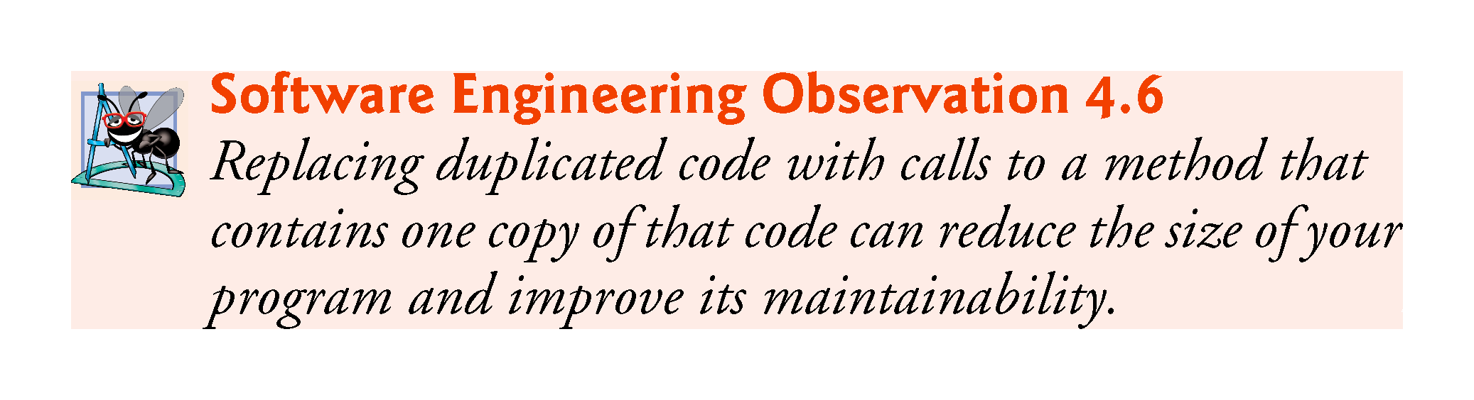

Slide 97
